Slide 1
Sheffield Strategic Partnership
Agenda – Thursday 23 November 2023
Attendance – a potential example of a new priority area for Sheffield.
Partnership Structure – developing a proposal for consultation in the new year.
Project page online: https://www.learnsheffield.co.uk/Projects/Sheffield-Strategic-Partnership
Working group next meeting: Friday 15 December (10-12pm)

Slide 2
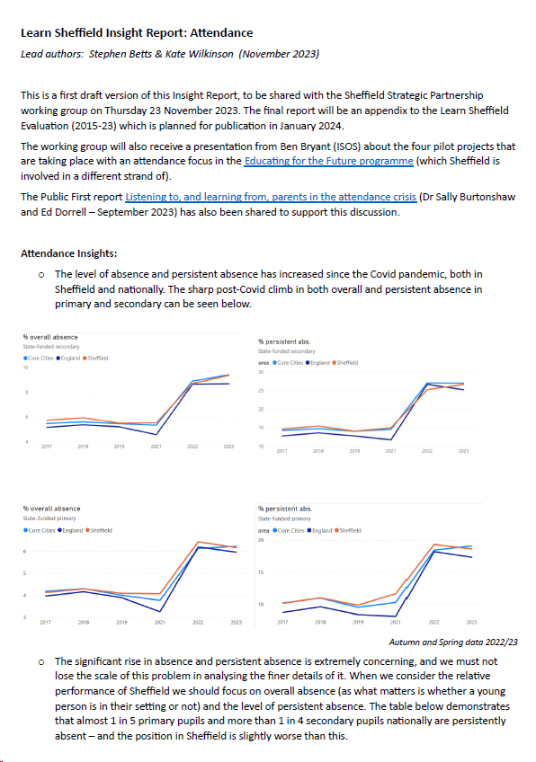
Sheffield Strategic Partnership
Agenda – Thursday 23 November 2023
Attendance – a potential example of a new priority area for Sheffield.
Three inputs:
Ben Bryant (ISOS) – learning from the Educating for the Future Pilot
Public First report
LS Insight Report
Partnership Structure – developing a proposal for consultation in the new year.

Slide 3
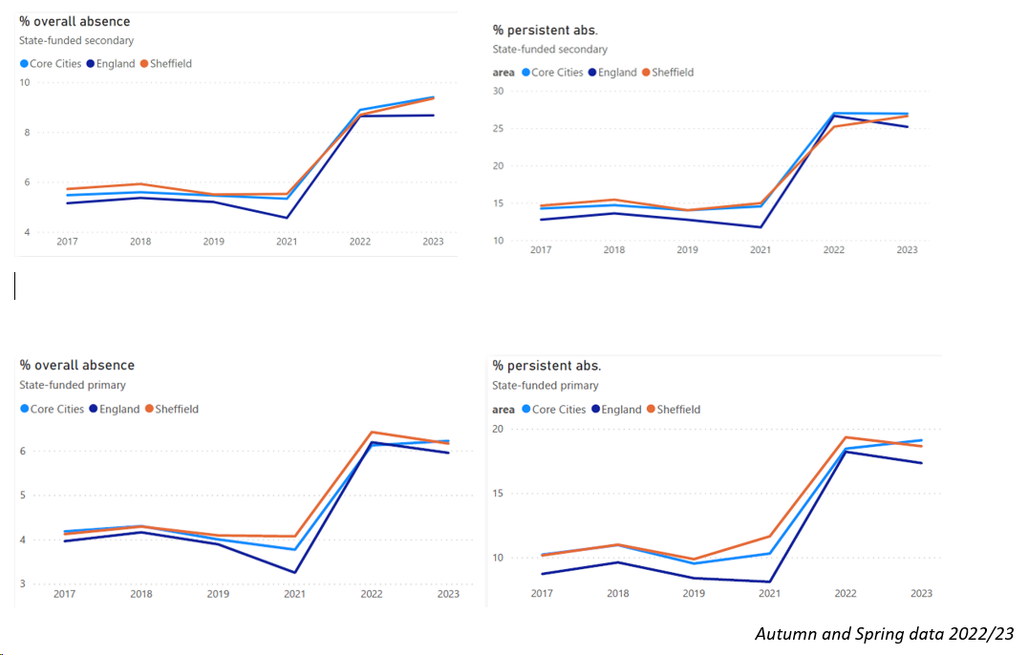
Attendance – LS Insight Report
Sharp post covid climb
Focus on overall absence
Sheffield coding interesting
Persistent absence – keep focus on big picture

Slide 4
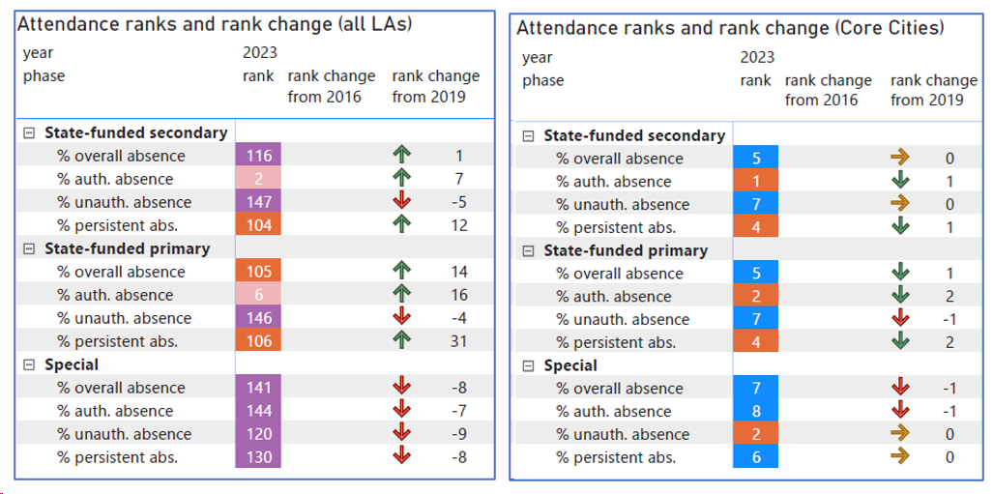
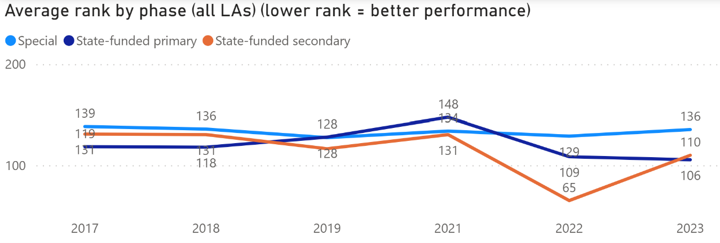
Attendance – LS Insight Report
Sharp post covid climb
Focus on overall absence
Sheffield coding interesting
Persistent absence – keep focus on big picture
LA rankings third quartile and broadly in-line with deprivation
Core City rankings 4th or 5th of 8
Absence in special schools requires further analysis
Hypothesis: Sheffield is the 2nd strongest core city for Ofsted outcomes … if it was also 2nd for attendance it would probably also be 2nd for attainment

Slide 5
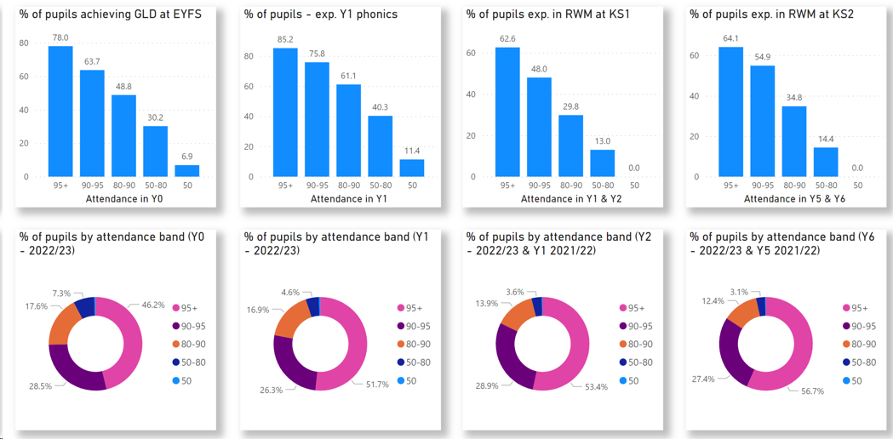
Attendance – LS Insight Report
When we analyse attainment by bands of attendance we can see both the breakdown of each cohort by bands and the decreasing likelihood of reaching the required standard for each stage as the band of attendance reduces
The graphic also shows that the proportion of primary children with 95%+ attendance is lowest in the youngest age groups.
Similarly, analysis of the factors which are determinants of lower attainment demonstrates that prior attainment and level of attendance are the two most significant factors. When controlling for other characteristics, we find that when a young person drops from 95%+ to the 90-95% attendance band their likelihood of achieving the expected standard for their age drops by approximately 50%.

Slide 6
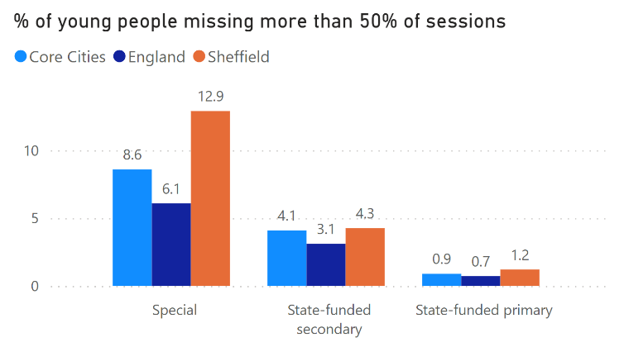
Attendance – LS Insight Report
Proportion of young people whose attendance is below 50% is significantly below national and core cities
Further analysis will shortly follow which analyses absence by pupil groups within the cohort. We will also reasons for absence, including the proportion of absences due to holidays.
Further analysis would also be beneficial to understand the nature and scale of increased absence within the cohort, in particular whether the increased number of missed days comes from all attendance bands or is focused more specifically on particular bands.

Slide 7
Attendance – LS Insight Report
Summary:
We would consider attendance to be an obvious priority for Sheffield and suitable for a civic partnership response. This is because:
The impact of improved attendance would lead to improved attainment and improved life chances for children and young people in Sheffield.
This improvement requires a wider partnership response. Each partner (including education settings) can always improve their practice, but unless all partners contribute a significant improvement in attendance outcomes will not be realised.
The footprint of this work may also need to stretch beyond the City and include, for example, transport which is a significant barrier to attendance for some young people.
Next steps: continue to follow the suggested trails to complete the report this term.

Slide 8
Sheffield Strategic Partnership
Agenda – Thursday 23 November 2023
Attendance – a potential example of a new priority area for Sheffield.
Three inputs:
Ben Bryant (ISOS) – learning from the Educating for the Future Pilot
Public First report
LS Insight Report
Partnership Structure – developing a proposal for consultation in the new year.

Slide 9
Attendance – Public First Report

Slide 10
Attendance – Public First Report

Slide 11
Attendance – Public First Report

Slide 12
Sheffield Strategic Partnership
Agenda – Thursday 23 November 2023
Attendance – a potential example of a new priority area for Sheffield.
Partnership Structure – developing a proposal for consultation in the new year.
Project page online: https://www.learnsheffield.co.uk/Projects/Sheffield-Strategic-Partnership
Working group next meeting: Friday 15 December (10-12pm)

Slide 13
Sheffield Strategic Partnership
Project page online: https://www.learnsheffield.co.uk/Projects/Sheffield-Strategic-Partnership
Next meeting: 15 December (10-12pm)… focus on consultation draft for January publication.

Slide 14
Sheffield Strategic Partnership: LS Input (1/11/23)
Annual Needs Analysis Process
Sheffield Strategic
Education Partnership
Open process of consultation and identifying membership of task & finish groups
Attendance
Research & analysis capacity
Independent Chair
Priority Task & Finish Group
Defined membership appointed by nominations & elections
Sector Partnerships:
Primary / Secondary / Special & IR / MAT Strategy
SCC & other partner organisations
Priority Task & Finish Group
Locality HT Partnerships
Related boards

Slide 15
Sheffield Strategic Partnership: LS Input
Consultation content:
Partnership led by an independent chair
Membership designed to connect to and reflect the existing infrastructure
Small board (8-10) – from the infrastructure supplemented by co-options by chair to provide balance
Priorities addressed through task & finish groups to maximise the expertise involved
Receive annual needs analysis and ‘commission’ short inputs on identified trails
Open and innovative consultative approach to analysis to ensure transparency and credibility
The priorities are determined by which are the biggest issues where civic activity can bring about change/impact

Slide 16
Sheffield Strategic Partnership: LS Input
Further discussions:
Clear rationale for the purpose of the partnership – designed to be consciously different to existing – needs setting out
Approaches to analysis and consultation need more detail
Consider the timeline of the cycle – Needs Analysis lands most naturally in late autumn/early spring
Set out how the members will be identified and what the objectives are when co-opting further members to ensure balance
Resources for the partnership structure (and the priorities) needs to outlined and sourced
Approach to oversight and monitoring of impact needs to be clear
More detail is required to set out how/why the partnership will promote shared values, collaboration, support and challenge for all stakeholders, etc.

