Slide 1
Administering the Phonics Screening Check to Y2 Pupils
Autumn Term 2020
Diane Stokes

Slide 2
The purpose of the Y1 Phonics Screening Check
The Y1 Phonics Screening Check is to confirm whether individual pupils have learnt phonic decoding to an appropriate standard.
Pupils who have not reached this standard at the end of Year 1 should receive appropriate support from their school to ensure they can improve their phonic decoding skills, and will then have the opportunity to retake the check.
In June 2020 the Phonics Screening Check did not take place for Year 1 pupils. . .

Slide 3
So…
In the 2020/21 academic year only, it is statutory for schools to administer a past version of the Phonics Screening Check to Year 2 pupils during the second half of the 2020 Autumn term and return the results to the LA.
Year 2 pupils who meet the expected standard in phonics in the Autumn check will not be required to complete any further statutory assessments in phonics. Year 2 pupils who do not meet the expected standard in the Autumn check will be expected to take the statutory check in June 2021, alongside Year 1 pupils.
Pupils who do not meet the standard should continue to receive support in phonics.

Slide 4
Key dates:
Friday, 23rd October – Braille versions to be ordered if required.
Autumn 2 (Monday, 2nd November – Friday, 18th December) – schools must administer a past version of the check to Y2 pupils.
By the end of term (Friday, 18th December) – schools submit results to the Local Authority.

Slide 5
Which pupils should take the Autumn check?
All pupils who will reach the age of 7 by the end of the 2020/21 academic year.
Most of these pupils will be in Y2
Headteachers may decide it is not appropriate for a pupil to take the check. Where this is the case, you must explain this to the pupil’s parents. If appropriate, you should provide the parents with documentary evidence to support your decision and explain how you are helping the pupil to learn to decode using phonics.
The headteacher’s decision regarding participation is final.

Slide 6
Which pupils should not take the Autumn check?
Pupils showing no understanding of grapheme-phoneme correspondences (GPCs)
Pupils with limited fluency in English.
Pupils who use sign-supported communication to spell out letters but are not using phonics in the sense of linking letters and sounds.
Pupils who are mute or selectively mute.

Slide 7
Which check should be used?
Schools can choose from the past papers used in 2017, 2018 and 2019.
Schools should use the version that the pupils are least familiar with or the version that they completed the longest time ago.
Schools can use check materials from different years for pupils in the same cohort, if required.

Slide 8
How does the check work?
It will be a list of 40 words
There will be a mix of real words and pseudo words
Pupils will read the words one-to-one with a check administrator
Each check will take an average of 4-9 minutes per pupil.
A score of 32 is required to pass the check.

Slide 9
Who can be a check administrator?
A member of staff who is trained in phonics and has experience of delivering phonics sessions to pupils must administer the check on a one-to-one basis.
The role requires professional judgement about which responses are correct. The check administrator should be known to the pupils but must not be a relative, carer or guardian of the pupil taking the check.
The check should not be administered by a teaching assistant or a higher-level teaching assistant, unless they are trained in phonics and have experience delivering phonics sessions to pupils.

Slide 10
Overall structure
The screening check is divided into two sections:
Section 1
GPCs that are usually introduced first to pupils learning to decode using phonics
Simple word structures
Section 2
GPCs that are usually introduced later and graphemes that correspond to more than one phoneme
More complex word structures, including two syllable words

Slide 11
Section 1 graphemes
a ar b c ch ck d e
ee f ff g h i j k
l ll m n ng o oi oo
or p qu r s sh ss t
th u v w x y z zz

Slide 12
Section 2 graphemes
a a-e ai air ar au aw ay
b c ch ck d e ea ee
e-e er ew f ff g h i
i-e ie igh ir j k l ll
m n ng o oa o-e oi oo
or ou ow oy p ph qu r
s sh ss t th u ue u-e
ur v w wh x y z zz

Slide 13
Section 1 structure
Section 1 contains 12 pseudo-words and 8 real words
The words will have the following phonological structures
CVC
VCC
CCVC
CVCC

Slide 14
Section 2 structure
Section 2 contains 8 pseudo-words and 12 real words
The words will have the following phonological structures
CV
CVC
CCVC
CVCC
Two syllable words (real only) will contain a variety of phonological structures and will contain 5, 6, 7 and 8 letters.
CCVCC
CCCV
CCCVC
CCCVCC

Slide 15
Use of ‘sound buttons’
‘If a pupil uses ‘sound buttons’ to help them decode words as part of normal practice, they may use them during the administration of the check. You must give the child a clean copy of the check so that they can mark the sound buttons against the graphemes themselves. You must not mark the graphemes for the pupil.’

Slide 16
Success Criteria
Look for the split digraph
Mark it on
Look for digraphs/trigraphs
Mark them on
Dot the graphemes
Sound out
Blend to read

Slide 17
Maintaining the integrity of the check
Headteachers must ensure that all check administrators are appropriately trained.
They must ensure pupils’ responses are scored accurately and consistently.
They must report any incident that affects the integrity of the Autumn check by contacting the NCA helpline.

Slide 18
Preparing to administer the check
Read the Check Administration Guidance (CAG) and carefully consider how the check will be introduced.
Watch the scoring video
Consider which paper should be used
Order Braille versions if appropriate
Consider need for access arrangements
Choose and prepare a room for the check
Ensure copies of the CAG are in the room

Slide 19
Preparing check rooms
Ensure the area is quiet and well lit.
Displays or materials that could help pupils should be removed.
Additional rooms may be required if more than one adult is administering the check to pupils at the same time.

Slide 20
Access arrangements
You must consider the needs of each pupil individually.
You can make access arrangements at the school’s discretion. For example:
Rest break
Use of modified versions of the screening check materials. (Some are already available on GOV.UK)
Font, font size, fewer words per page, coloured paper
Use of coloured overlays
Rephrasing instructions and use of gestures

Slide 21
Scoring the phonics screening check
Video available https://youtu.be/IPJ_ZEBh1Bk
Detailed guidance of acceptable pronunciations of pseudo words available in Scoring Guidance Document

Slide 22
Scoring marks
Alternative plausible pronunciations of pseudo words -
allowed
Alternative plausible pronunciations of real words –
not allowed
Scoring of pronunciation difficulties –
professional judgement
Pupils’ accents –
professional judgement (but note advice on video)
‘Children can use any acceptable regional pronunciation, even if it’s not within their usual accent. Regional pronunciations are acceptable.’
Indicating whether a word is correct or incorrect –
not allowed

Slide 23
Pupils sound out letters/phonemes before blending -
allowed
A pupil sounds out correctly but then says the wrong word -
not allowed
A pupil self corrects -
allowed if done reasonably promptly
A pupil leaves gaps between phonemes –
not allowed
A pupil is prompted to blend or have another go –
not allowed

Slide 24
Submitting data to the LA
Description
What to record
Description | What to record
Pupils took the check | Score - record in the phonics mark field
Absent | A - record in the phonics outcome field
Headteacher decided it was not appropriate for pupil to take check | D - record in the phonics outcome field
Pupil has left the school | L - record in the phonics outcome field
Check is subject to maladministration | Q - record in the phonics outcome field

Slide 25
Pupils who change schools
Before October half term
New school assesses and submits
After October half term
New school should find out whether screen has been taken. If not, they should assess and submit. If it has, the school where it was taken submits and provides result to new school via common transfer file.
During the Christmas holiday
Previous school should have assessed and submitted.

Slide 26
Reporting results to parents
Results must be reported in annual school report to parents
Must state whether expected standard has been met
Both sets of results must be reported if the check is taken in both the Autumn and the Summer
Results should also be included in pupils’ CTFs - both times if necessary

Slide 27
How the DfE will use data
Data from the Autumn check will be used by DfE to determine which eligible pupils have not met the expected standard in phonics by the end of the 2020 Autumn term, and are therefore expected to take the statutory check in June 2021 (alongside Year 1 pupils). These aggregated results will be used to create the school-level ‘expected lists’ provided to LAs to help inform their monitoring of the June 2021 check.
Pupil level results will be added to the National Pupil Database.
Data from the Autumn check will not be added to Analyse School Performance or reported in national statistics, but schools should use the assessment outcomes to help inform their own teaching and support to pupils.

Slide 28
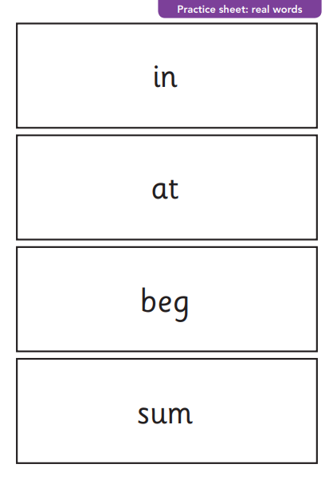
Practice sheet

Slide 29
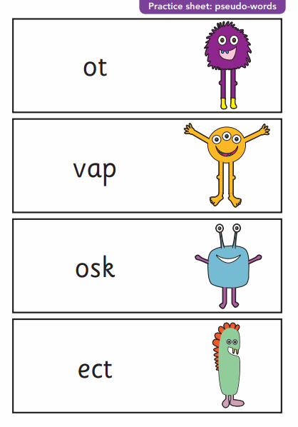
Practice sheet:

Slide 30
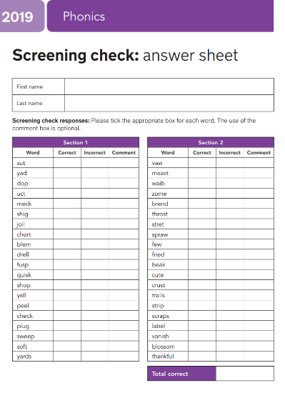
Example recording sheet

Slide 31
Recording sheet close-up

Slide 32
