Slide 1







Inclusion of pupils with SEND in Physical Education, School Sport & Physical Activity
Kim Horton
Development Manager Links School Sport Partnership
School Games Organiser – All Saints SGO Hub

Slide 2
Introduction
Attendees will have to chance to reflect and review their practice and delivery of effective PESSPA provision for children and young people with special educational needs and disabilities.
Explore a range of resources available to support teaching and differentiation
A chance to share good practice and discuss specific scenarios in your school.
An opportunity to network and make contacts with others in similar settings facing similar issues

Slide 3


Slide 4
Inclusive PE, School Sport & Physical Activity
Will help ALL pupils reach their full potential
Will give EVERY pupil the opportunity to participate in PE lessons, Clubs & Competitive opportunities
Create an environment that recognises the value of differences and that focuses on the different abilities of CYP rather than a disability
Allows delivers to adapt the content and delivery of lessons with confidence, so that all students’ different abilities can shine through
Provides all children and young people with the opportunities to develop:
  Social Skills
  Personal Skills
  Physical Skills

Slide 5
5 Tops Tips to Inclusive PESSPA
Aim for whole Class PE Lessons that provide all pupils with the same opportunities to take part and contribute at their own level – Inclusion Spectrum Framework
Talk openly about Inclusion & that everyone is different
Get to know your pupils
Consistent routines to support transition between learning environments
Identify any barriers to learning

Slide 6
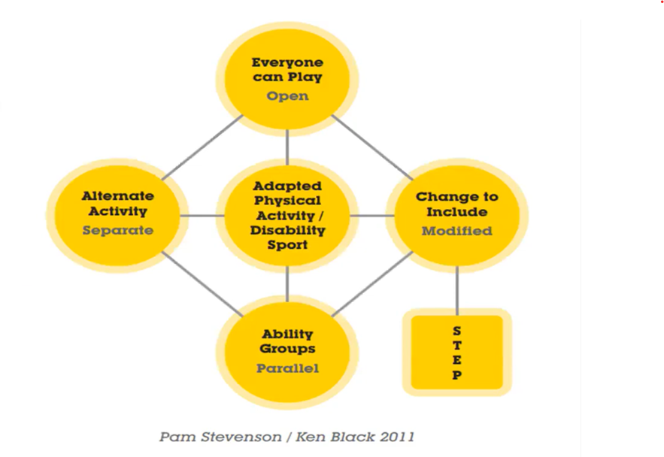
Models to Inclusion: Inclusion Spectrum
Black & Stevenson (2011)
An activity centred approach where inclusion is achieved by changing the way in which the activity is delivered
By delivering activities differently we can balance different needs within the group and help maximise potential for all pupils

Slide 7
The Inclusion Spectrum Framework
Open/Everyone can play – naturally inclusive activities based on what everyone can do with little or no modifications E.g. warm ups and cools downs, where children can find the level of participation that suits them
Parallel/Ability groups – participants are grouped according to ability - each group does a version of the same activity, but at a level which suits the individuals in each group. For example: creating two or more versions of the same activity, (e.g. a standing version and a seated version of volleyball).
Alternate or separate activity – individuals work temporarily on specific skills leading to more successful inclusion in the whole group; sometimes, in order to include someone more effectively, they need to practise separately first. This should only be in the short term and not a permanent arrangement.

Slide 8
The Inclusion Spectrum Framework
Disability sport/adapted physical activity – aspects of physical activity based on adapted activities or disability sport programmes can be included in all approaches; providing specific opportunities for disabled students and a new challenge for non-disabled students - ‘reverse integration’
Modified/Change to include – everyone does the same activity using adaptations to provide both support and challenge across a range of different abilities; the STEP model (space, task, equipment and people) can be used to provide a structure for adapting and modifying the activities

Slide 9
The STEP Framework
Space – Where is your activity taking place? Can you increase or decrease the size of the area or distance between players
Task – What is happening? Can we break complex movements into smaller component parts to develop understanding of skills. Provide time for practice, repetition and rest periods as needed
Equipment – What is being used? Can we send or receive a ball indifferent ways, use a chute or gutter to send and a catching mitt to receive
People – Who is involved? Can we match participants of similar ability in small sided games

Slide 10




Inclusive PE Resources & CPD
Top Sportability – https://topsportsability.co.uk YSTINCLUSION39
Active Kids for All https://www.youthsporttrust.org/sainsbury%E2%80%99s-active-kids-all-inclusive-pe
MATP & Special Olympics file:///C:/Users/kimho/Downloads/MATP%20Single%20Page%20summary%20with%20links%20(1)%20(1).pdf
https://www.specialolympics.org/our-work/sports/motor-activity-training-program
School Games Inclusive Health Check file:///C:/Users/kimho/Downloads/School_Inclusive_Health_Check_flyer%20(1).pdf
All About Autism All About Me https://www.youthsporttrust.org/system/files/all_about_autism1.pdf
ITT Training Toolkit physicaleducationpe.pdf staff audit
10 Top Tips to adapt activities for young people.pdf
afpe.org.uk/physical-education/wp-content/uploads/Head-Hands-Heart-Web.pdf

Slide 11

The Rowan School – Sensory Circuits Resource
Sensory Circuits
Alerting Stations
Organising Stations
Calming Stations

Slide 12

SEND & Inclusion in School Sport
Inclusive Health Check Action Plan
Competitive opportunities – personal best challenge, Intra-school, class v class, inter-house competitions, Inter-school fixtures and events against other schools.
Extra curricular clubs
Links to community sport and activity, engaging families and key partners

Slide 13

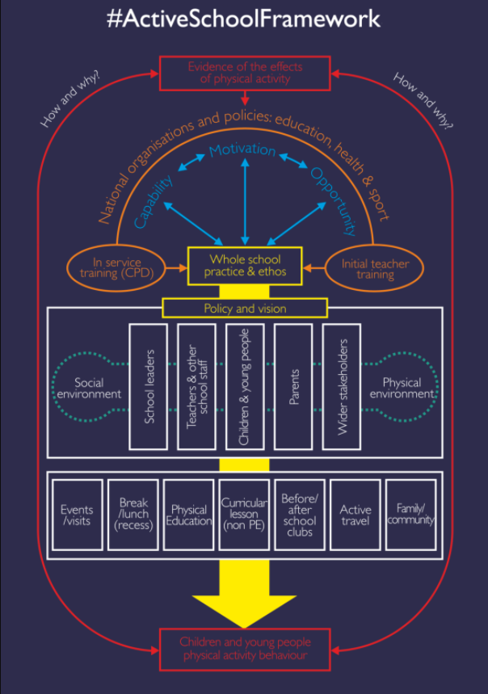
Physical Activity
Creating an Active School Framework - 60 Active Minutes YST Active Schools Planner, Active Schools Wheel
YSF Alex Ogden Top Tips for promoting physically active learning
Active Interventions - Active Lessons, Active Breaks & Lunchtimes Movement Breaks, Active Blasts – Move More Schools
Sensory Circuits

Slide 14
Key Contacts & Thank you!!
Kim Horton
Development Manager Links School Sport Partnership
All Saints SGO Area
Contact: kimhorton.links@gmail.com
Adam Fuller
Development Manager Arches School Sport Partnership
Forge Valley SGO Area
Contact: AFuller@forgevalley.sheffield.sch.uk
Nathan Barthrop
Development Manager Forge School Sport Partnership
Handsworth Grange SGO Area
Contact: forgesdo@hotmail.com
Helen Stevens
Development Manager Points Learning Network
Contact: hcstevens@btinternet.com
Andy Staley
Westfield SGO Area
Contact:A.Staley@westfield-chorustrust.org

