Slide 1
30 years of Stonewall.
30 years of progress.
An assembly for secondary schools and colleges
Notes:
This assembly is aimed at mainstream secondary schools and colleges. SEND settings may wish to look at the SEND or mainstream primary versions of this assembly. Have a look out for our other 30th Birthday resources for ideas for lessons and other activities.
Introduce the assembly, explain to students that you are Stonewall School Champion school. Explain why LGBT inclusion is so important.
We’d love it if you could hold an Equali-tea at your school to help us celebrate our 30th birthday and to help us raise money to put towards our work with schools, colleges and young people. More information is provided on the final slide of this assembly.

Slide 2
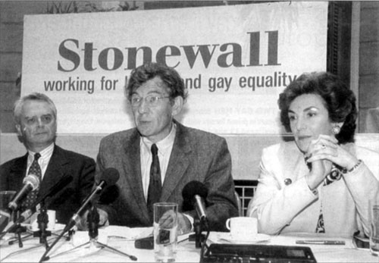
What is Stonewall?
Acceptance without exception
Stonewall is an LGBT charity which was set up in 1989 to oppose Section 28.
Stonewall now works with schools, colleges, workplaces, sporting bodies and many other organisations.
Stonewall’s aim is acceptance without exception for all LGBT people.
Notes:
Read through the slide content. Ask: Stonewall have been going since 1989, why might Stonewall still need to work with schools? Talk about the fact that there is still a lot of homophobic, biphobic, transphobic bullying and that schools need support to tackle that. Discuss that lots of teachers are still learning how to include LGBT themes in the curriculum.

Slide 3
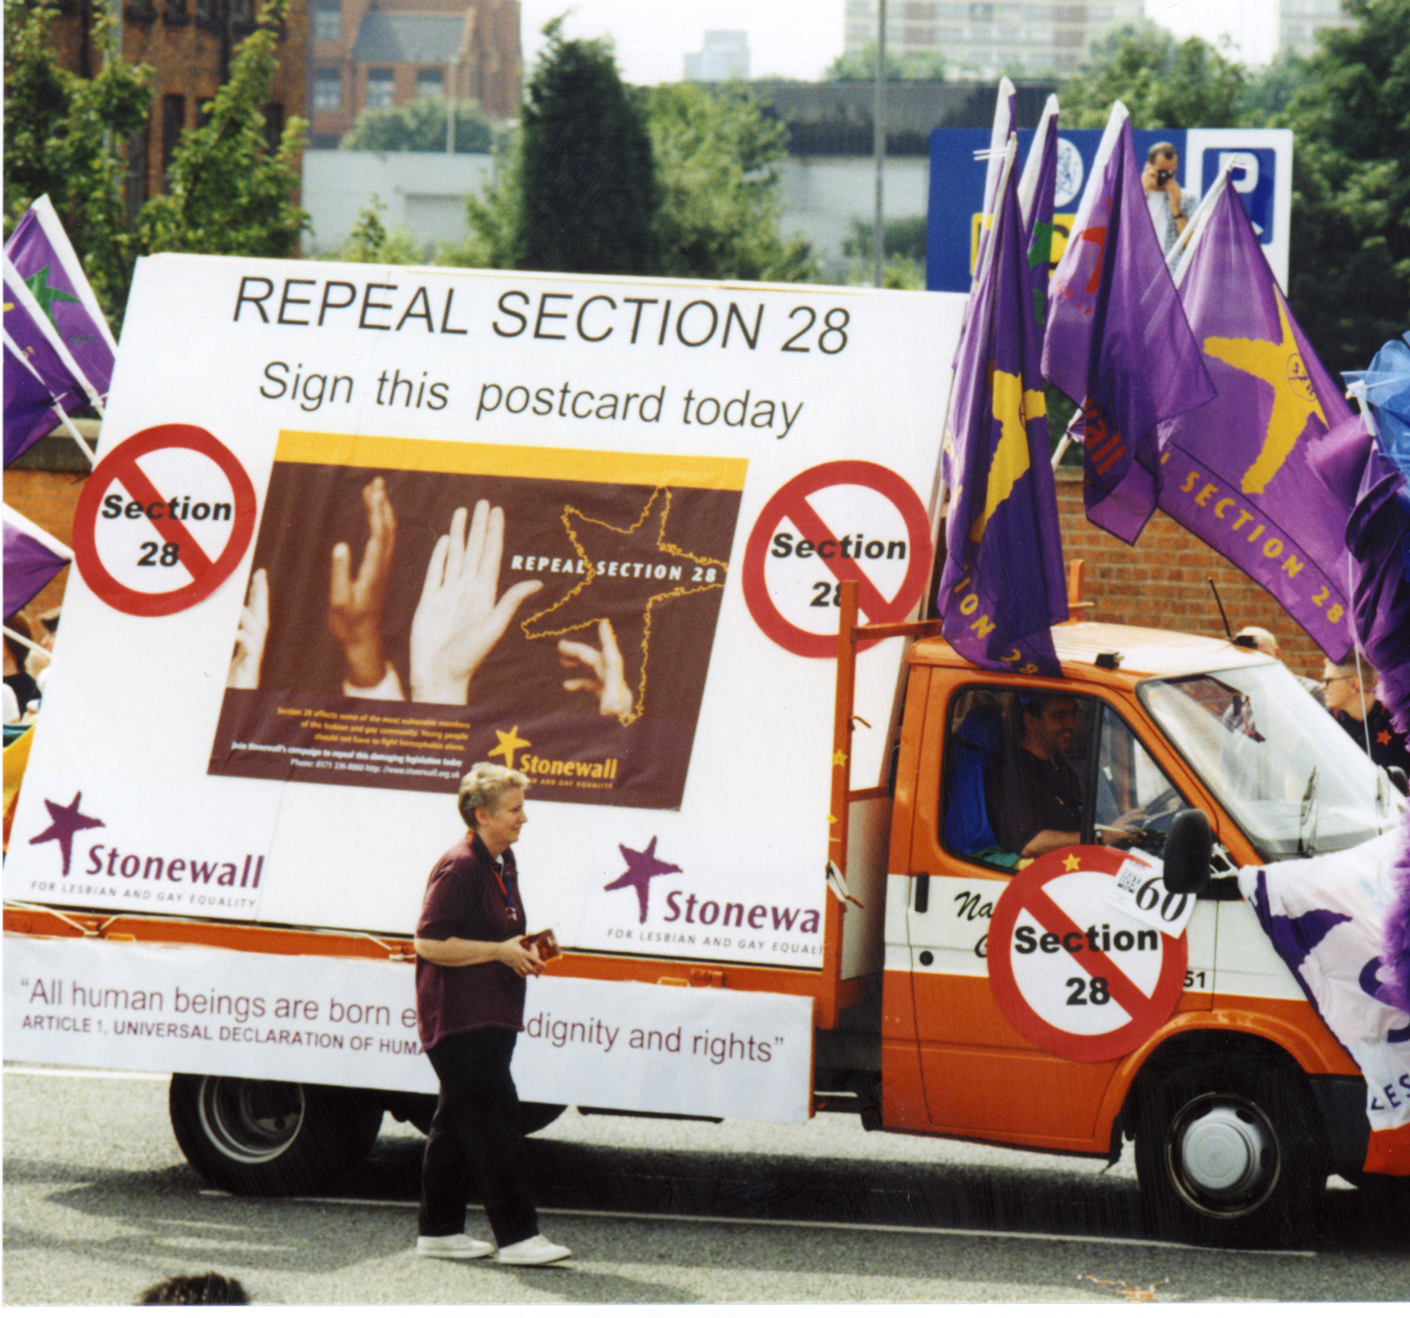
What was Section 28?
Illegal books
Section 28 was a law that made it illegal for schools to teach about LGBT relationships.
Schools could not use books with an LGBT focus and teachers weren’t allowed to talk about LGBT role models.
This assembly would have been against the law.
Notes:
Read through the slide content. If you were teaching during Section 28, relay your own experiences. Ask students: What impact would Section 28 have had on LGBT young people? Talk about the feeling of being an outsider, not seeing yourself represented, not learning how to keep yourself safe.
If you are using the timeline activity, complete it now. Ask 10 students to the front, give each a timeline card and ask them to put themselves in the order they think the events happened in.

Slide 4
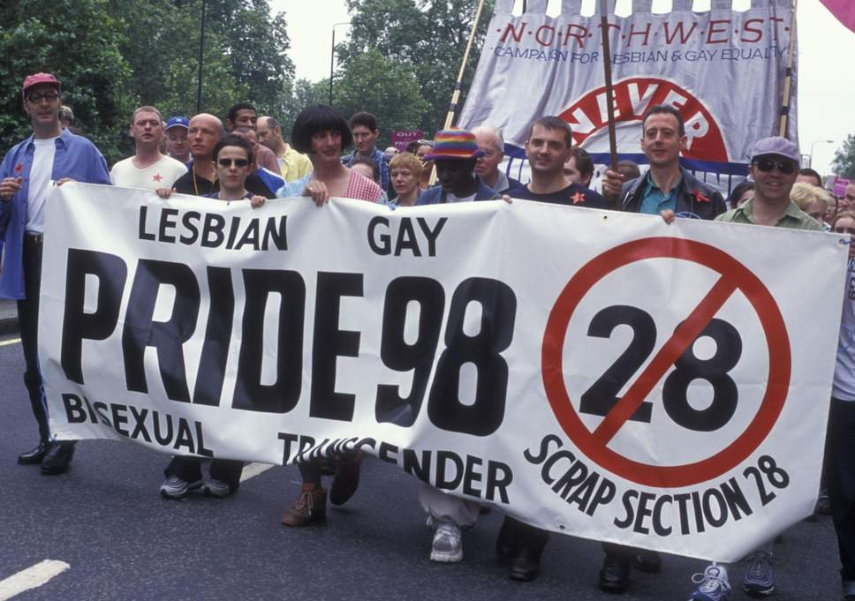
2003
Goodbye Section 28
In 2003 Section 28 was repealed – this means that it was no longer a law.
Schools were free to talk to children and young people about LGBT issues.
The most popular song was ‘Where is The Love’ by the Black Eyed Peas
Arsenal won the Premier League.
Notes:
Read through the slide. Ask students: Why is it important for schools to be able to talk about LGBT issues? Explain the importance of understanding different people’s identities and promoting respect for diversity, the importance of LGBT people seeing themselves represented in the curriculum, the importance of LGBT people being able to learn how to keep themselves safe.

Slide 5
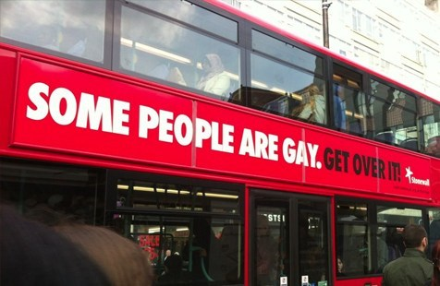
2007
Equality Act
The Equality Act made it illegal to discriminate against LGB people.
This meant that people had to be treated fairly at work and in other areas of life.
Stonewall launched the ‘Some People Are Gay. Get Over It’ campaign.
‘Umbrella’ by Rhianna was popular.
Notes:
Read the content of the slide. Ask students: What would it feel like to not be given a job because of something about yourself that you can’t change? (ie being LGBT)

Slide 6
2010
An update
The Equality Act was updated to make it illegal to discriminate against trans people.
Before then trans people could be legally discriminated against.
‘Bad Romance’ by Lady Gaga was popular.
Spain won the football World Cup.
Notes:
Read the content of the slide. Ask students: How would it feel if you were told that you couldn’t use the toilets that match your gender? Reflect that this could have happened prior to trans people being included in the Equality Act.

Slide 7
2013
Let’s Get The Meaning Straight
Stonewall worked with young people to design some posters to challenge homophobic language.
‘Get Lucky’ by Daft Punk was popular.
Australia won the Rugby League World Cup.
Notes:
Read the content of the slide. Ask students: Why is it important to challenge homophobic, biphobic and transphobic language? What is the impact of using gay as if it means something bad? Discuss the impact in particular on LGBT students and staff.

Slide 8
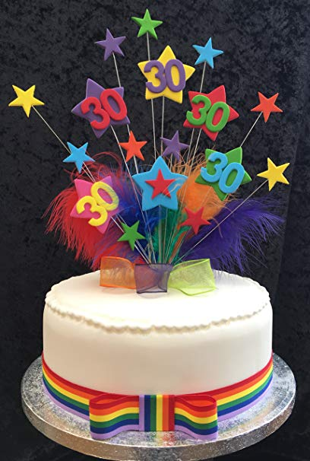
2019
RSE for everyone
This year, Parliament has voted to make RSE LGBT inclusive.
What a great way to celebrate Stonewall’s 30th Birthday.
We’re still waiting to find out what the most popular song of the year is.
Notes:
Read through the content.

Slide 9
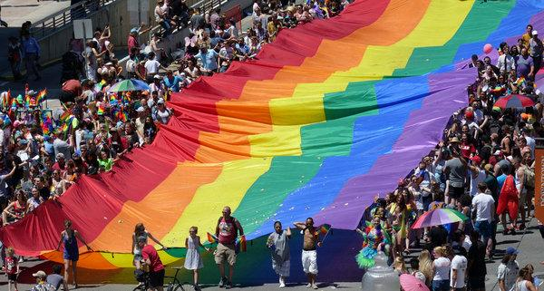
2019 and beyond
What will you do to challenge homophobic, biphobic and transphobic language?
What will you do to show that LGBT students and staff are welcome at our school?
Notes:
Ask students to think about the questions and then share their thoughts.

Slide 10
2019 and beyond
We will be holding our school Equali-tea at TIME on DATE to raise money for Stonewall.
Get baking and bring some cakes or biscuits for us to sell.
Remember to bring some money so that you can celebrate Stonewall’s 30th Birthday with a sweet treat.
Notes:
Share details of the School Equali-Tea on this slide. Find more information here: https://www.stonewall.org.uk/equali-tea

