Slide 1
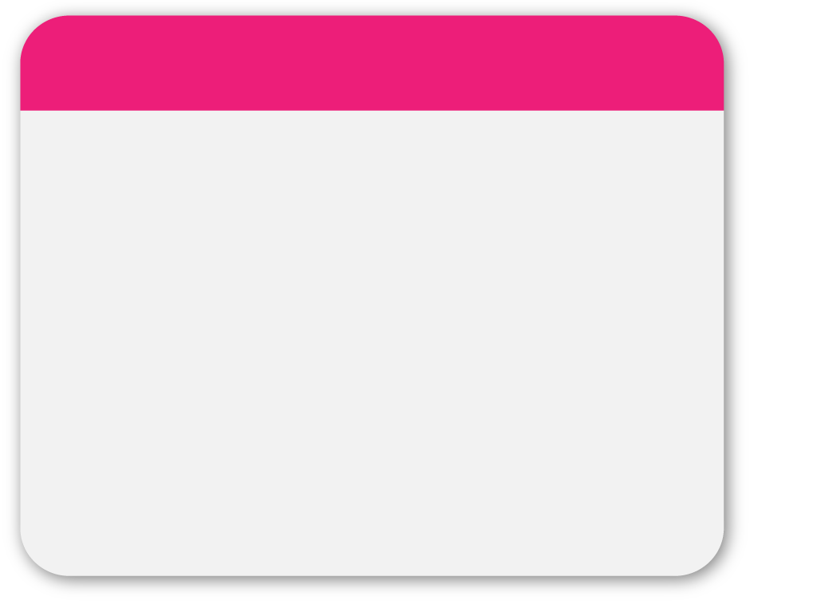
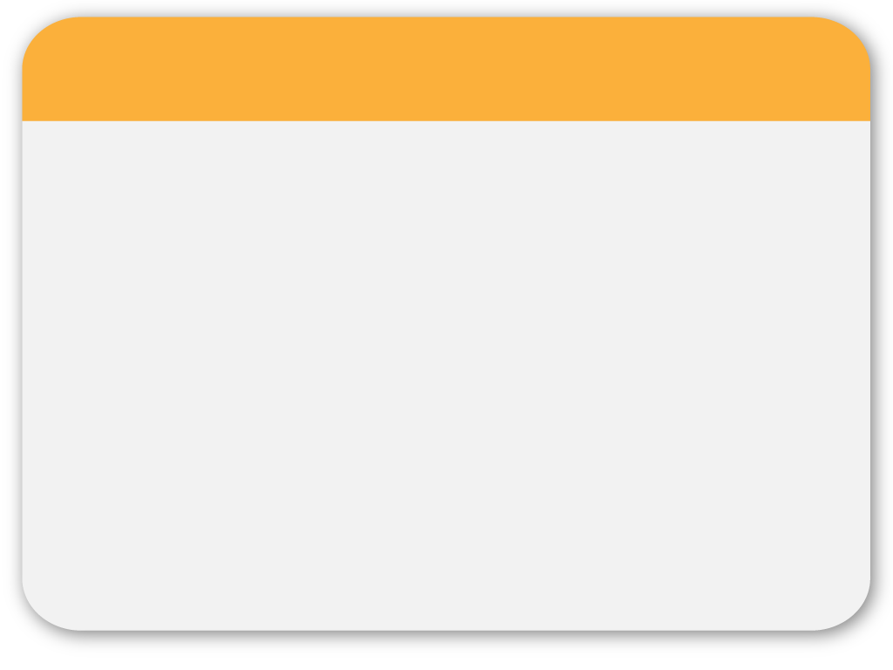
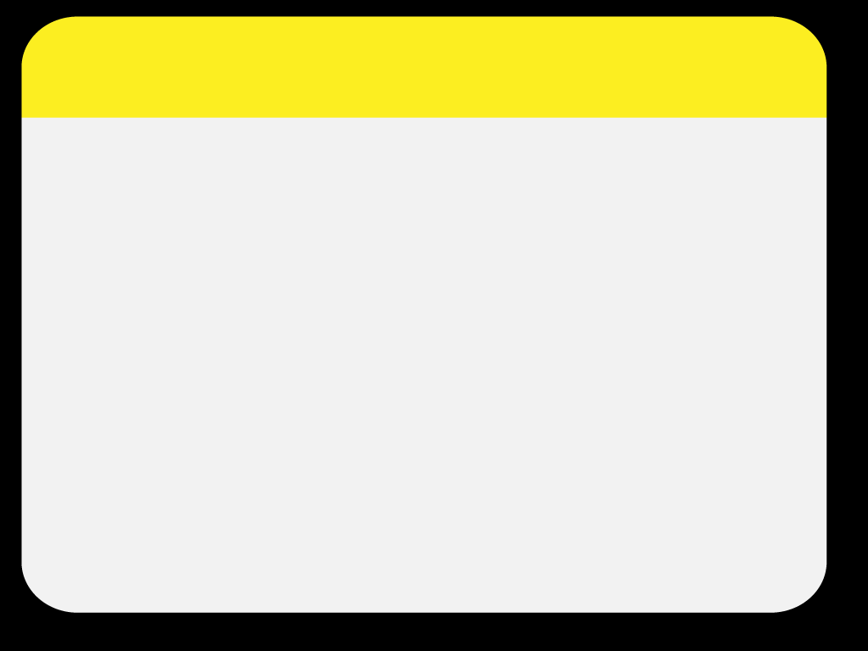
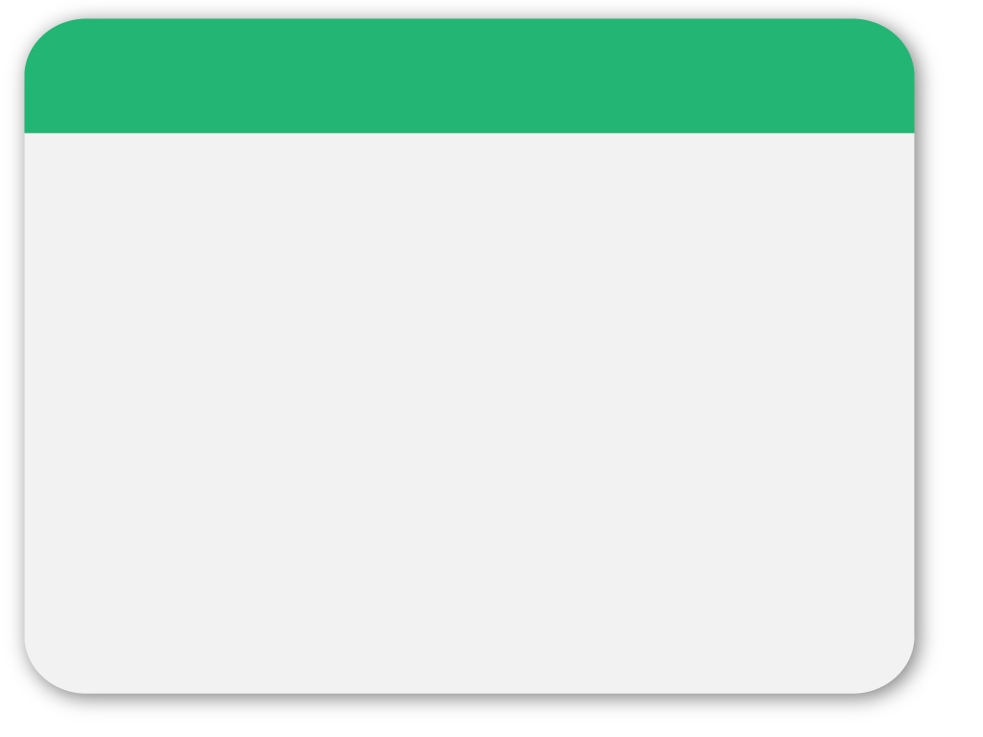
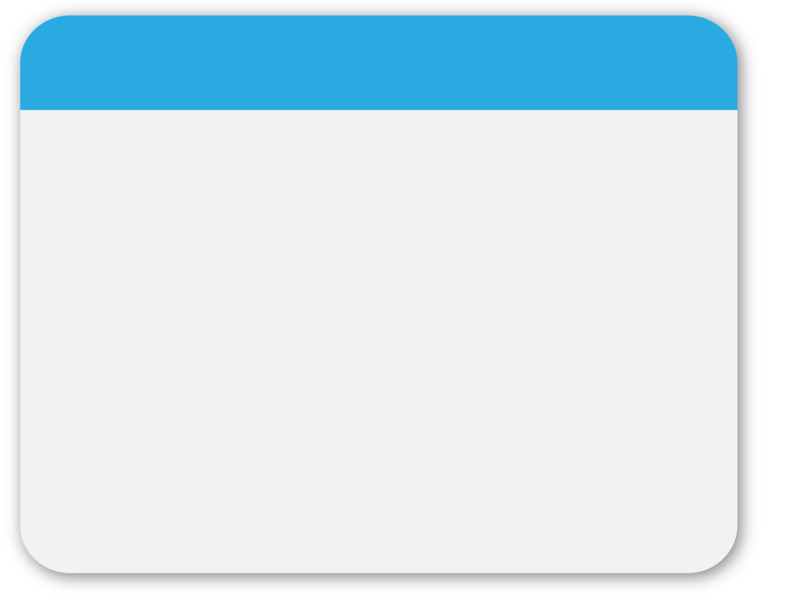
01
WINTER
My Plan
Template
Area SENCO training pack
Notes:
Introductions / role

Slide 2
02
Why should we use a My Plan
When to use a My Plan
How to use a My Plan
- when compiling
- when compiled
Notes:
Written with a view to Area SENCos sharing this info with school sencos

Slide 3
03
The My Plan prototype has been built using Wakefield’s format and feeding in some of the requirements in the new SEND Target Operating Model.
Notes:
Developed by members of the SEND team
Where we percieved the My Plan to fit in with our children

Slide 4
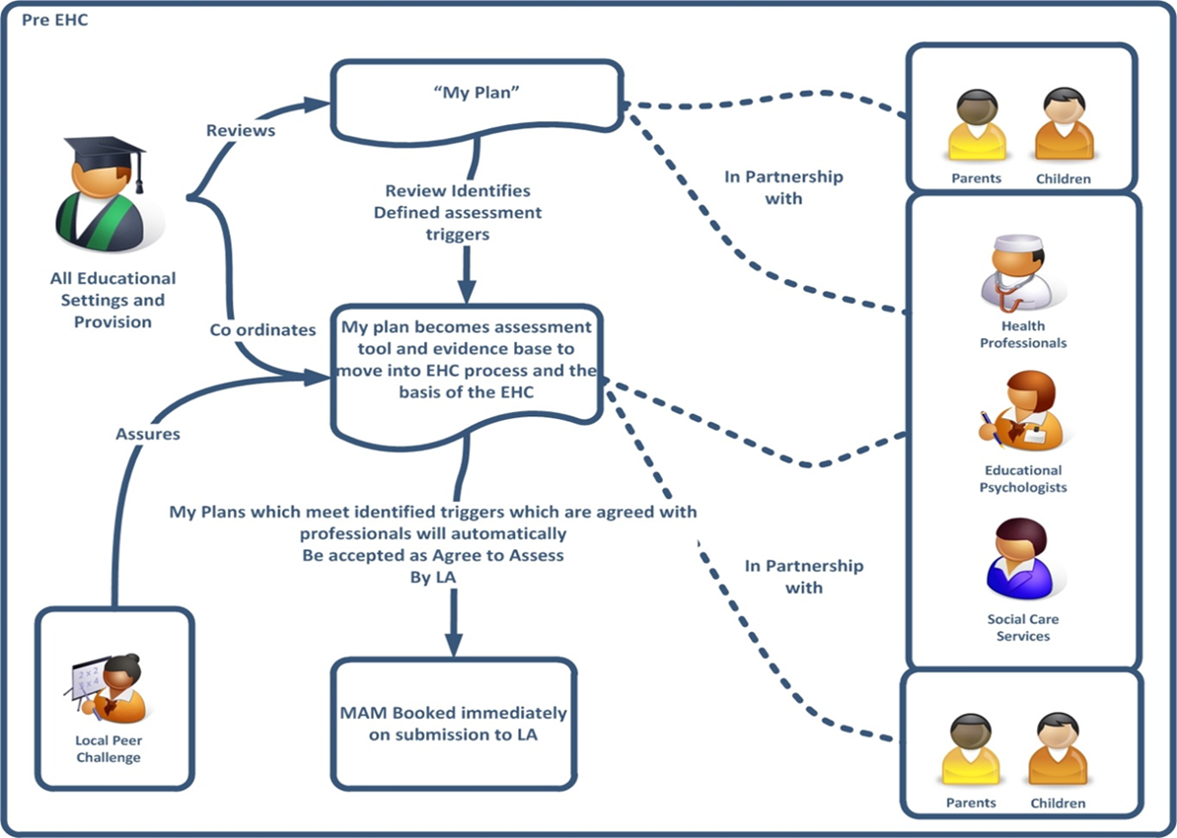
04
Notes:
Where the my plan could fit? Picture version for visual learners!!

Slide 5
05
Why should we use a My Plan?
Allows us to capture/collate information in one place.
Gives us a clear evidence trail of the assess – plan – do – review cycle.
Requires input from parents AND the child as outlined in the Code of Practice. This information is then used when planning outcomes together for the young person.
Has been produced to look very similar to an EHCP, helping to build parental confidence in using a My Plan and reducing EHCP requests.
Notes:
Evidence of assess-plan-do-review cycle sometimes missing when applying for an EHCP. Careful planning of support and recording of progress has demonstrated no need for an EHCP, in some cases.

Slide 6
06
When should we use a My Plan
For young people who have needs that fit at Level 3 or above on the Sheffield Support Grid. There may be cases where this does not need to be the case e.g. when the young person has a Communication Plan in place.
For young people who have needs that fit at Level 1 or 2 of the SSG if this is felt to be beneficial. For example,
- young people approaching a point of transition
- where there may be reduced parental confidence
- new starter to school
You can use the My Plan as an immediate Request to Assess, by ticking the box on the front cover and giving reasons for this in the ‘History and Background’ section.
Notes:
My Plan ‘feels’ as if there is an increased level of accountability in school for the young person, building parental confidence.

Slide 7
07
How should we use a My Plan – putting it together.
The form is designed to be used in a variety of ways. Sometimes it is only necessary to write a One Page Profile for a young person, which is why this section has now been placed at the front of the document.
When agreeing to run a My Plan/setting a date/time for the meeting with families we usually share the document and ask parents to think about their section, ready for the meeting.
Invite all professionals involved with the child to the meeting, letting them know it is a My Plan meeting.
Prepopulate the My Plan prior to the meeting with information gathered from SEND file and staff in school.
Notes:
OPP example – LG where new diagnosis given, coping well in nursery slowly guiding mum through the process.
OPP example – new starter, previously displaying very challenging behaviours. Meeting within first week to gather her tips on what works well and what she doesn’t want.
OA section – to quickly gather who is involved with the nursery child who has quite significant needs.
History and background – for a new starter (previous 4 schools) to get a clear picture of what has happened to date. Lived with a dif family for a part of this time.
Share good/not so good examples of completed sections.

Slide 8
08
The My Plan meeting
In the meeting the focus is usually on gathering parent views, the OPP and generating outcomes. This can sometimes be done in one meeting or may take a couple. Again, this is flexible.
The SSG needs to be referred to, which can be done with parents, to select the most applicable level/s for the young person. The SSG also gives information about how the outcomes can be worked towards.
There is further guidance available that gives detailed support for each area of the form (My Plan Guidance Notes V2.3).
Notes:
Examples of My Plans

Slide 9
09
WINTER
Points to remember;
Put yourself as one of the professionals supporting the child.
Don’t forget to put the young person’s current levels of learning within the ‘History and Background’.
There may well be more than one SSG level, where a child has several areas of need.
Write in the areas of strength as well as the areas of need. This is quite commonly missed out.
The ‘steps towards meeting the outcome’ section should be mini outcomes, rather than ‘how’ the outcome will be met. The ‘how’ is filled in on the next page in the My Plan.
Use SMART targets, where specific progress information can be detailed when the My Plan is reviewed.
Template
Notes:
Some localities are having training on specific assessment tools that they can use to show understanding of a child’s needs and progress over time e.g. WRAT4.

Slide 10
10
After the My Plan meeting
Check/edit the My Plan once it is typed up and allow parents the opportunity to do this also.
Send a copy to the Area Senco so that it can be quality assured.
Follow any advice and/or make any amendments following the QA process.
Circulate to all involved with the young person.
Review the My Plan a minimum of 3 times each year. There is no upper limit on how many My Plan reviews can be held.
Notes:
Sections of the OPP

Slide 11
11
The role of the Area SENCo in the My Plan process
The Area SENCo may have been invited to a My Plan meeting for a young person, especially if the case is deemed complex or is an escalation to a Request to Assess.
Use the quality assurance document to assess the My Plan against.
This is designed to be a supportive process that helps SENCOs to ensure that they are doing everything necessary for the young person.
Notes:
I have already attended meetings for children where there are thoughts that a R2A may be needed down the line. The My Plan information has also fed into the FOS Action Plan that we have devised to allocate SEND funds. Process encourages all schools to engage.

Slide 12
12
Moving to a Request to Assess
There is an expectation that the My Plan will have run for a minimum of two terms before it is escalated into a Request for an EHCP (unless put in as an immediate request).
If it looks like escalation to EHCP might be needed at the next review this is also indicated by ticking the box and discussing the plan with the Area SENCO and SEND Manager. Advice must have also been sought from an Educational Psychologist, following the new systems in place in the EP team. Usually the Area SENCO will already be aware of the young person.

Slide 13
13
WINTER
If proceeding to a Request to Assess
Template

Slide 14
14
Closing a My Plan
If the young person is making good progress against their targets or their level of need decreases, it may be agreed in a My Plan review that the document is no longer necessary.
If this is the case, complete the ‘Planned Closure’ section of the My Plan and file away the document. It may be necessary to continue with the One Page Profile element of the My Plan and/or return to using an IEP.

Slide 15
15
Renewing a My Plan
The My Plan is designed to run for three assess – plan – do – review cycles which generally fill a three terms. At the end of the year you begin a new My Plan document copying over the sections that you would like to continue e.g. ‘History and Background’ etc.
Continue on with the new My Plan document as previously.

