Slide 1
EHC Plan – Annual Reviews
Training for education providers and advisory services
Academic year 2020/21

Slide 2
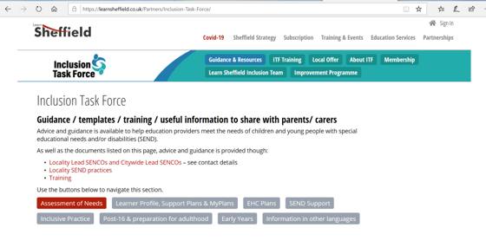
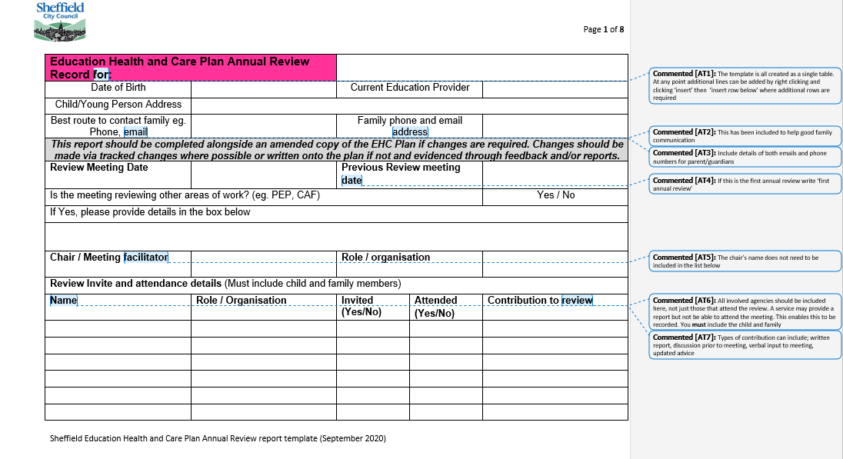
Introduction
Training delivered in 3 parts:
Training power point
Round table discussion
Further training and Q&A
Updated paperwork and guidance document – available on learnsheffield/Inclusion Taskforce website
Notes:
Meeting host to share slides / documents and spot light on presenters as needed in zoom throughout

Slide 3
Session aims
To explain how to review Education, Health and Care needs, provision and outcomes through a single plan
To embed a process of review rather than a review meeting
To make sure that the child is central to the process
For all SENCOs to understand the practical requirements of an EHC Plan annual review
For advice givers and advisory services to understand their role in the review of an EHC Plan
To explain what should be done before, during and after a review meeting
To answer questions that SENCOs and services have about the annual review process

Slide 4
What is an annual review?
A legal requirement
Cycle of assess – plan – do – review
The route to monitor progress throughout the year
Involving services and advice givers as needed
Annual process of evidencing what’s working, what’s not working and what needs to change
Route to monitor that provision in the plan is in place
SEND Code of Practice 9.166-9.185
Regular review of progress – 3 times a year – Code of Practice 6.64-6.71
https://youtu.be/zwdLXbhKA0A
Vital to ensure that a child's needs are being met in line with their statutory plan
Notes:
Video not to be played but for reference after session – or could be played as an overview depending on time

Slide 5
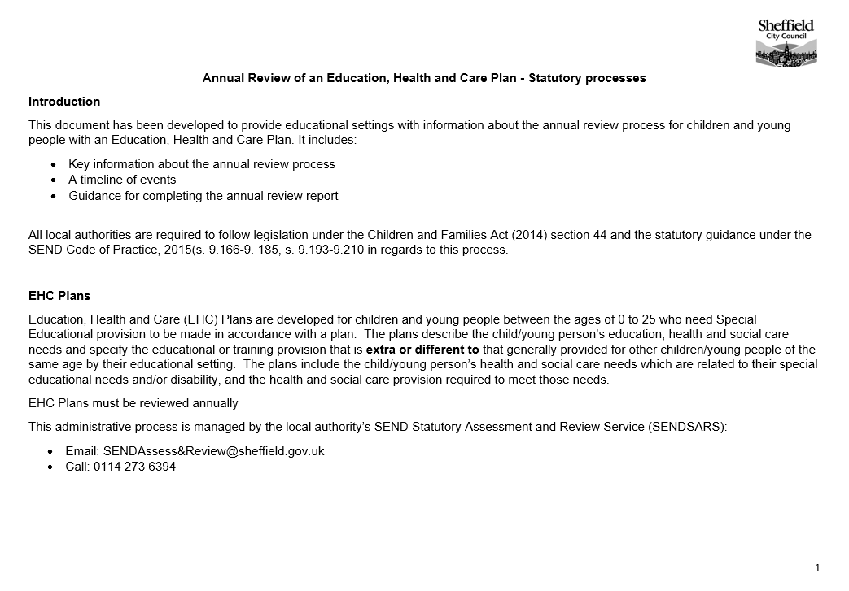
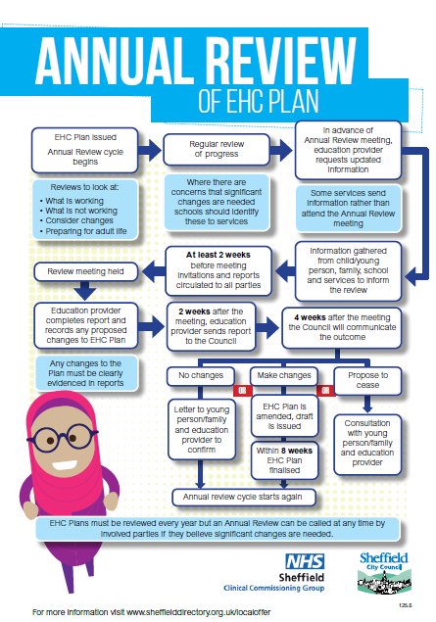
Timelines
A reminder – it’s a process, not a meeting
Local Authority discharges its duties to arrange the review to education providers
Starts when initial plan / decision to make amends or not is issued
Plan through the year and follow key timelines
Every 6 months for children under 5, annually for those of school age unless there’s a need to complete the review earlier
https://www.learnsheffield.co.uk/Downloads/InclusionDocuments/20-21/EHC%20Plan%20annual%20reviews%20Nov%202020.pdf
https://learnsheffield.co.uk/Downloads/InclusionDocuments/19-20/Education%20Health%20and%20Care%20Plans%20-%20Annual%20reviews%20statutory%20processes.docx
Notes:
Share and show 2 documents – documents also in training packs alongside powerpoint

Slide 6
Notes:
Talk through timeline – particular focus on preparation and process

Slide 7
Some important extra dates
Reviews for children moving to a different phase of their education must be completed early enough to allow time for the local authority to consult with educational settings and make any changes to the plan by:
15 February for children moving from early years to primary school, infant to junior school and primary to secondary school
31 March for children moving from secondary school to post-16 settings, and between post-16 settings
Notes:
Why is it a deadline and what do we do at that point? Need to clarify legal expectations and dates worked towards - why does this matter to you and to parents

Slide 8
Pause and think
What has worked well for you in the annual review process
What are the biggest challenges for you in addressing annual reviews?
Pause this video for a few minutes and reflect on these questions
Record any questions you have as we will look to answer these in the Q&A session
Notes:
No feedback session but allows participants to consider the challenges as a context

Slide 9
During the year
Put in place provision in the EHC Plan
Evidence gathering – how provision in the plan is put in place, impact of that provision, how provision is contributing to outcomes
Involvement of agencies to support provision in the plan or where there are additional needs identified, particularly if expectation of changes being made – may require additional reports
Progress reviews throughout the year evidenced through support plan – good communication with the child and their family
Notes:
how do you record evidence through the year and what type of evidence - can include info from meeting with services during the year. Who can you talk to about this? eg change of need, change of SEP, etc

Slide 10
Measuring outcome and impact
Setting and measuring outcomes
Evidence impact
Holistic approach – including health and care provision
Training on outcome setting will cover further how to measure outcome and impact
Notes:
If outcomes training has already been completed then include link to recording

Slide 11
The meeting – beforehand
The process through the year is essential to ensure the meeting can summarise the review
Administration – invites, time, length, location etc
Gathering the child’s voice
Parent participation
Involving services
Required paperwork
Notes:
Meeting summarises the review process that has been ongoing
Reference back to process documents provided in timeline slide – particularly focus on child and parent voice and why it’s important
Paperwork will be covered in round table in more detail
The process through the year is essential to ensure the meeting can summarise the review
Administration – invites, time, length, location etc
Gathering the child’s voice – how will they participate
Supporting the parent to access the meeting
Where a service is essential talk to them about why you want them there and how they can contribute
If substantial changes will be needed, for example placement, you must discuss this with assessment services in advance of the meeting
Consider the paperwork that is needed – current EHC plan to be annotated, Annual Review report, gathered evidence

Slide 12
Pause and think….
What has worked well in your experience in the work beforehand
What are the barriers to the work beforehand
Pause this video for a few minutes and reflect on these questions
Record any questions you have as we will look to answer these in the Q&A session

Slide 13
The meeting
Person centred approach – Myth busting: Person centred is not about great drawing but about asking the right questions
Hear everyone’s voice – particularly the child’s
Share information from those not there
A discussion not completing a form
Key parts include:
- Person – centred discussion – what’s working, not working and needs to change
- Progress against outcomes
- Preparation for Adulthood (Y9 onwards)
- Proposed changes to the EHC Plan
- Agreed actions and next steps
Notes:
Take through annotated report during this slide – also focus on reviews being about hearing what’s working not a discussion about ‘the problem’

Slide 14
Person Centred Questions
What are your strengths? What are your child’s strengths?
What do you like? What does s/he like?
What do you like and admire about your child?
What do others like and admire about your child?
What is important for him, now and in the future?
What is important for you now and in the future?
Who are the important people in your child’s life?
What is working for your child at home and at school?
What is not working for your child at home and at school?
How does your child learn best?
What needs to change?
What help does your child need?

Slide 15
Making changes to the plan
The review is the point to bring together proposed changes
Annotate the EHC Plan through tracked changes or written amends on the plan – identify evidence in reports
Primary and secondary needs
Recording SSG levels
Change of placement –involve external agencies
Ending a plan
Re-assessment
Where there is disagreement as to the proposed changes this must be recorded
Notes:
Need to stress on amends in plan not to include everything, how to ensure SENCOs are clear on what needs to go in and not
The review is the point to bring together proposed changes
Where possible annotate through tracked changes or written amends on the plan – if proposed changes are in reports then identify these and what should be included
Primary and secondary needs / Recording SSG levels
Change of placement –involve external agencies if you think this is required
Ending a plan
Requirement for re-assessment
Where there is disagreement as to the proposed changes this must be recorded

Slide 16
Making changes to the plan
Think about:
- Factual accuracy
- Curriculum
- Environment
- Skills required to meet needs
- The resources needed (financial, people, equipment, etc)
Notes:
Think about:
- Factual accuracy – if there are inaccuracies in the plan identify them and detail what they should be
- Curriculum – are further adaptations needed?
- Environment – are further adaptations needed?
- Skills required to meet needs – are the right services and skilled support involved and available?
- The resources needed – are these evidenced? (financial, people, equipment, etc)

Slide 17
Changes to sections of the plan
Section | Suggested changes | Evidence from
A – Views, interests and aspirations | Is information still relevant? If not then what should they say? | Parent and young people views
B – Special Educational Needs | Are strengths and needs accurate and articulated? If not what should change? Do needs reflect current assessments (eg learning levels)? | School assessments and reports Involved services – evidence in review, updated reports, service discussions
C – Health needs | Are health diagnosis and needs included and accurate? Have they changed? | Health reports and services Information from parents
D – Care needs | Are care needs included and accurate? Have they changed? | MAST, Social Care, Inclusion & Attendance Information from parents
Notes:
Table added to guidance documents
need to detail who should record what in discussions and drop ins - how do you gather discussion evidence
Advise as a crib to meeting - need to look at evidence, etc Doesn't need to be fully talked over.

Slide 18
Changes to sections of the plan (2)
Section | Suggested changes | Evidence from
E – Outcomes | Are outcomes relevant? Are they SMART? Are key areas covered? The Annual Review meeting is the process to make suggested additions and changes to outcomes plus the time to set new interim targets for the coming year | Annual review meeting, support from involved services

Slide 19
Changes to sections of the plan (3)
Section | Suggested changes | Evidence from
F – SEN Provision | Is all currently delivered provision in place that is required included in the plan? Is there additional provision that has been identified? | If school are putting in place substantially more than is identified in the plan then evidence from provision map and support from advisory services
G – Health provision | Is health provision in place or identified by health practitioners included in the plan? Health provision that ‘teaches and trains’ is in Section F | Health reports and services Information from parents
H1/H2 – Care provision | Is care provision in place or identified and agreed by services included in the plan? | MAST, Social Care, Inclusion & Attendance Information from parents

Slide 20
After the meeting
Complete the Annual Review report
Attach all relevant evidence from the year Ensure proposed amendments are identified on the EHC plan
Send all information to SENDSARS within 2 weeks of the review meeting
Copy to the family and involved services

Slide 21
The Report
Updated paperwork
Needs to be completed in full
Annotated version available
Paperwork created as a table so you can insert extra lines
Checklist at end

Slide 22
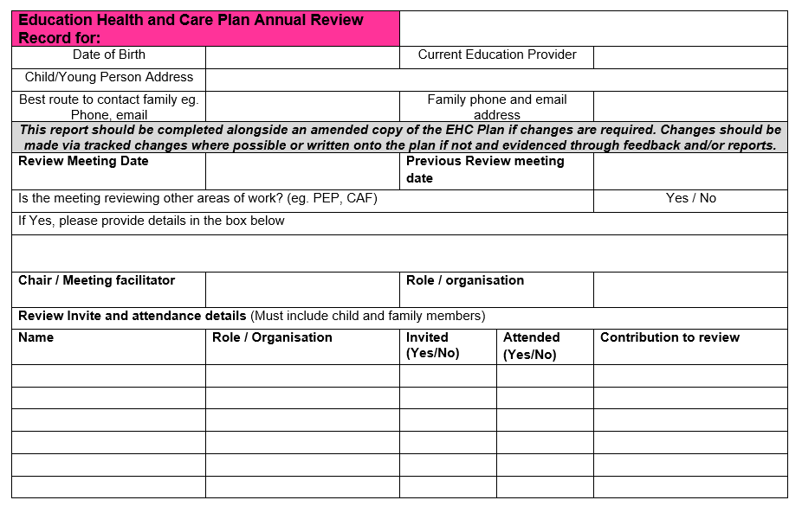

Slide 23
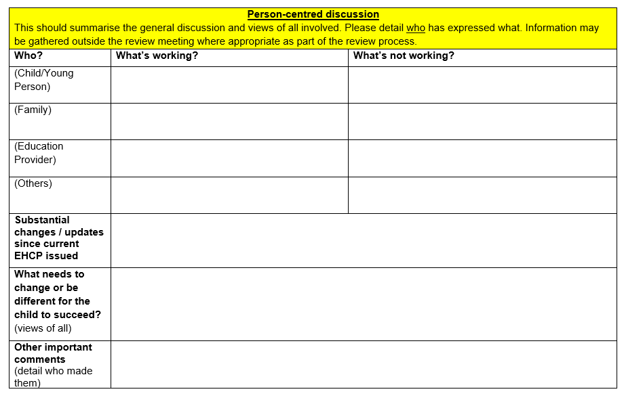

Slide 24
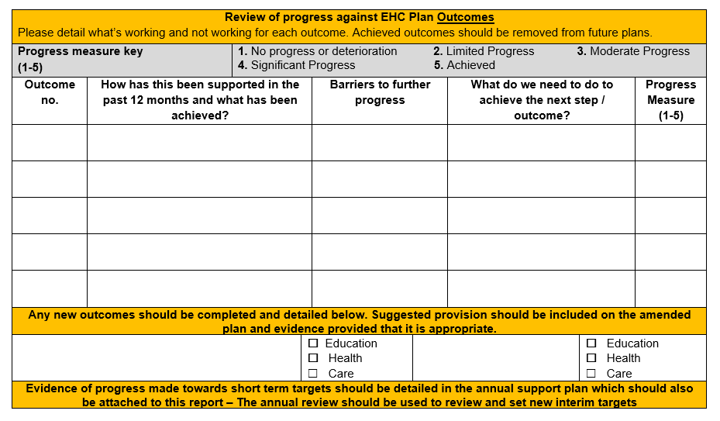

Slide 25
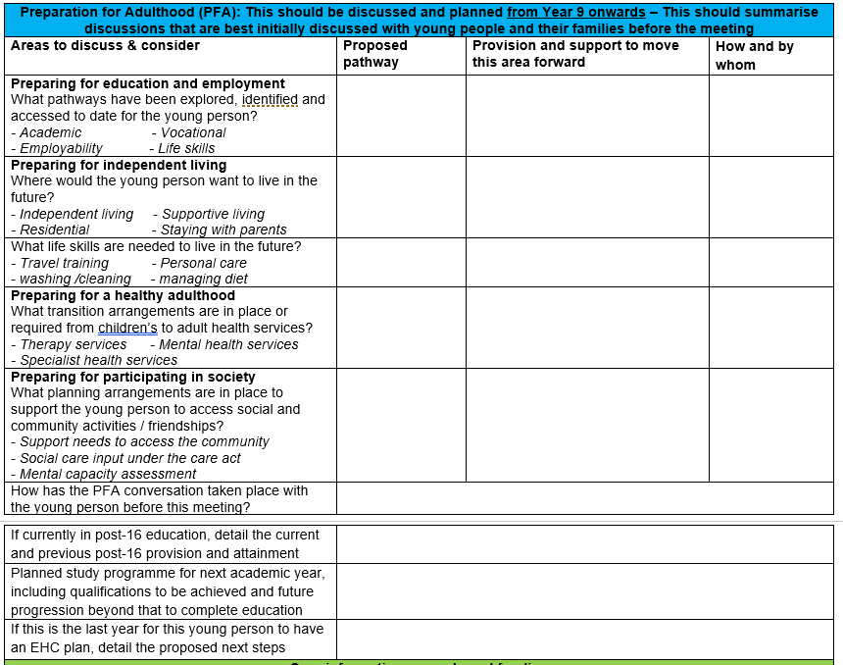

Slide 26
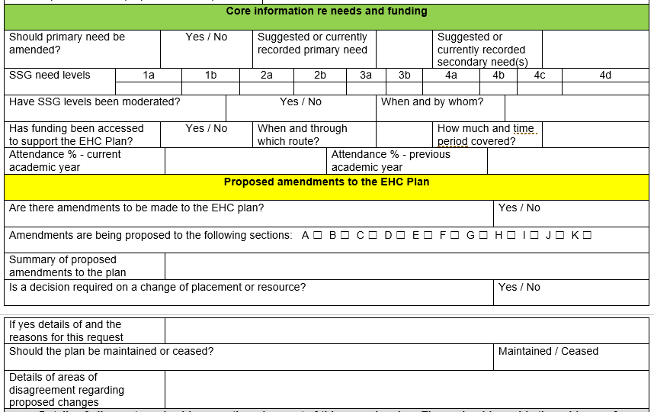

Slide 27
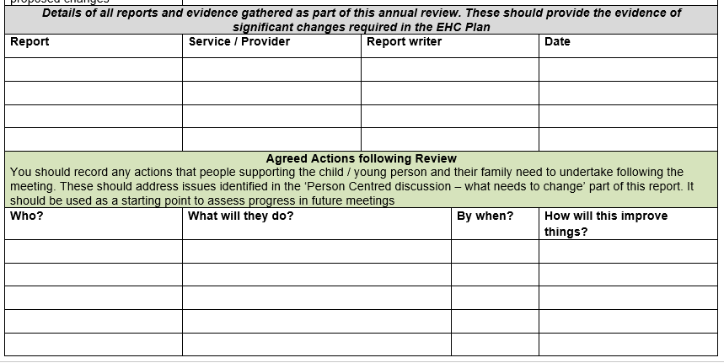

Slide 28
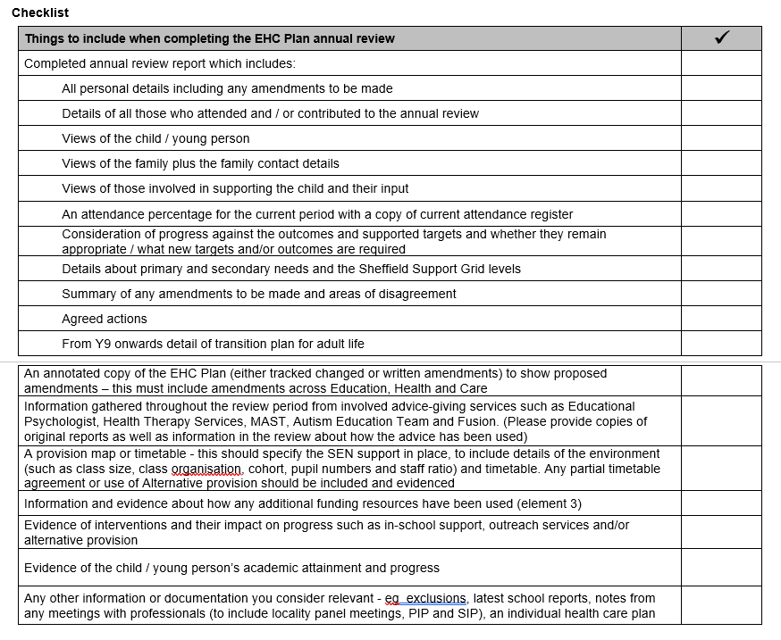

Slide 29
Pause and think….
Based on this what do you need to change in regards to your involvement with annual reviews?
Pause this video for a few minutes and reflect on these questions
Record any questions you have as we will look to answer these in the Q&A session
Notes:
No feedback session but allows participants to consider the challenges as a context

Slide 30
Training part 2 & 3
Part 2 round table discussion
Part 3:
Transition
Preparation for adulthood
What do SENDSARS do with the plan
Emergency / Early Reviews
Q & A

