Slide 1
What is the purpose of education?
What is the purpose of voluntary sector (and similar) organisations?
When/how do they have a common purpose?
What are the barriers to achieving this common purpose?

Slide 2
Role of Learn Sheffield
Who/What are we?
What are we trying to achieve?
How will we know if we have been successful?
What is the strategic vision – what are we going to do?
Stephen Betts (CEO - Learn Sheffield)
Thursday 14th July 2016
Emotional Wellbeing Stakeholder Event

Slide 3
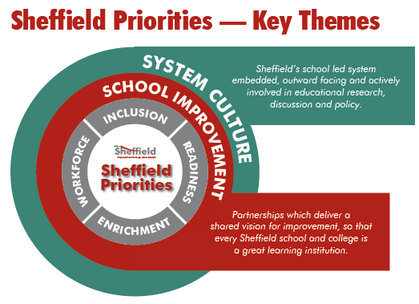
Purpose of education – better life chances …
achievement (opens doors)
& readiness (to walk through those doors)

Slide 4
Educational landscape – fragmentation
Overcome – pathways between schools and rest of the world … e.g. cultural partners
Mental Health
Physical Health
Attendance & Punctuality
Early Years
Transitions
Career Pathways
Citizenship

Slide 5
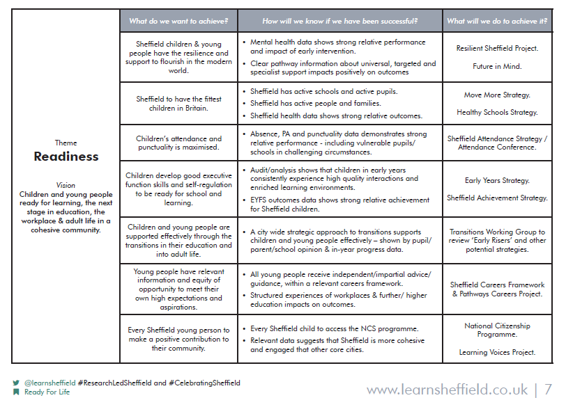
Readiness
Mental Health
Physical Health
Attendance & Punctuality
Early Years
Transitions
Career Pathways
Citizenship

Slide 6
What are we going to do to support schools to support vulnerable learners?
Why is the focus on schools?
What do we mean by vulnerable?
Why focus on learning?

Slide 7
We are going to create clear pathway information …
What do we mean by universal support?
What do we mean by targeted support?
What do we mean by specialists support?
S
T
U

Slide 8
What are the barriers to providing pathway information successfully?
Right Information – quality & objectivity
Accessible – delivery & communication
Sustainable – impact tracked & well maintained

Slide 9
How do we get the right pathway information?
Universal – key headline information (support identification)
Universal - signposting to more information / resources
Targeted – school interventions & provider contacts
Specialist – referral contacts

Slide 10
How do we deliver and communicate the pathway information?
Posters – recognisable format & systematic approach
Website – single known point of access
School ownership – identified workforce
System ownership

Slide 11
How do we ensure that the pathway information is up to date?
Each poster (aspect of vulnerability) needs to have a custodian
Custodians need to be commissioned/agreed
Impact needs to be monitored to determine quality and the depth of collaboration

Slide 12
Universal – Identification? Resources?
Group Exercise 1
What would good provision look like?
What do schools need to know?
What resources are available?

Slide 13
Targeted - Interventions
Universal – Identification? Resources?
Considering key principles of collaboration and quality …
Group Exercise 2
What do we need to ensure quality provision?

Slide 14
Next Steps
Include this work in the release version of the Priorities document
Design template produced
Commissions out – custodians and other providers identified
Pace! Completed, distributed & online within a hundred school days … February half term.

