Slide 1
2016 Primary
Assessment Update
27th September 2016

Slide 2
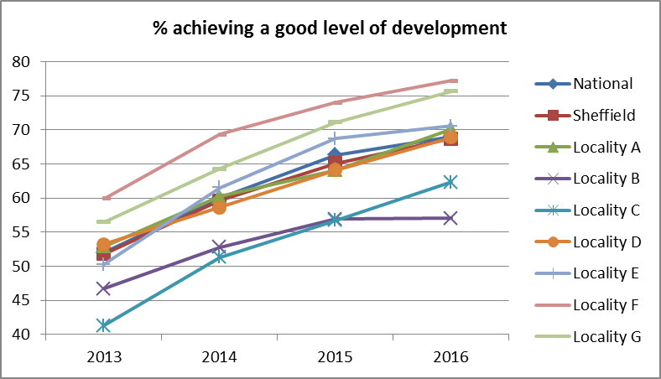
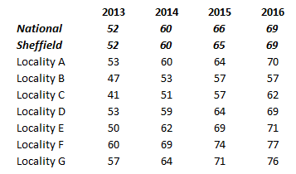
2016 Headlines – Foundation Stage
69% of children in Sheffield achieved a good level of development at the end of the Foundation Stage. This is equivalent to the provisional national result.
Provisional data indicates that the achievement gap has closed by 4% points to 31.7%.
All localities showing an upwards trend over the last 4 years.

Slide 3
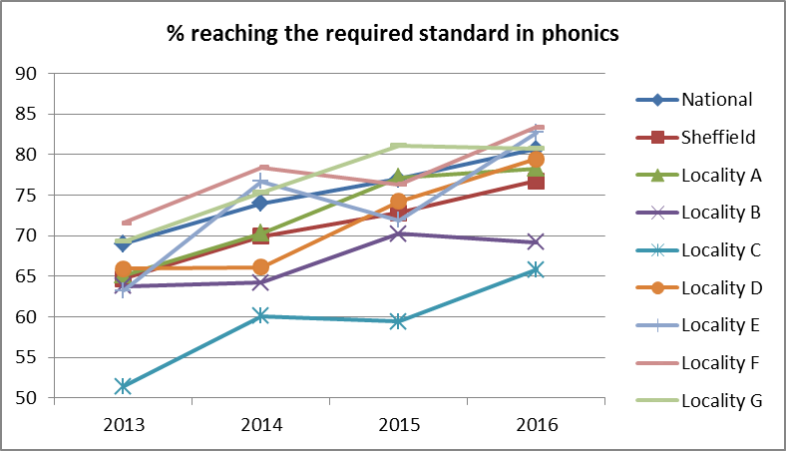
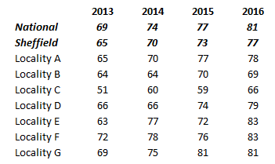
2016 Headlines – Phonics
77% of children in Sheffield achieved the required standard of phonics decoding. This is 4% points below the national average of 81%.
The gap between Sheffield and national has remained the same at 4% points.
All localities showing an upwards trend over the last 4 years.

Slide 4
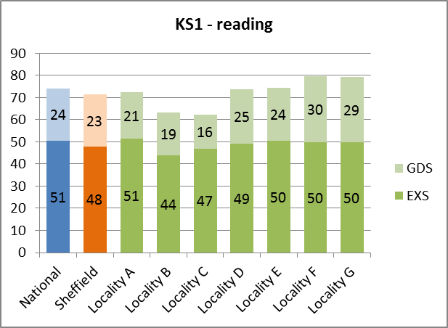
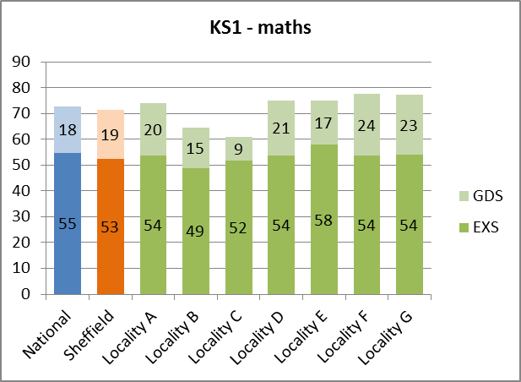
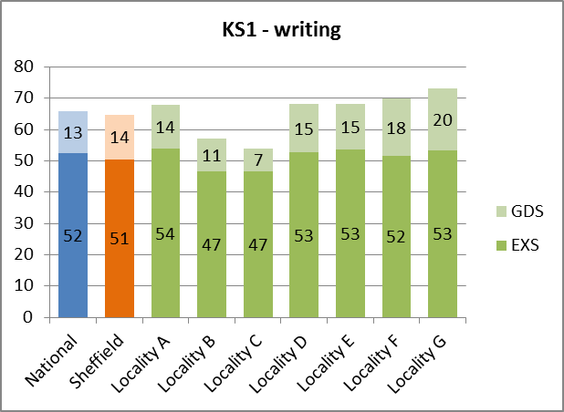
2016 Headlines – Key Stage 1
New assessment framework this year.
% of pupils working at or above the expected standard has dropped in Sheffield and nationally compared to % at level 2b+ in previous years.
% of pupils working at or above expected standard in Sheffield is: 71% (reading); 65% (writing); 71% (maths). Gaps with national are: 3% (reading); 1% (writing); 2% (maths). Compared to last year the gaps have increased in reading and maths (by 1% point) and narrowed in writing (by 1% point).
EXS – working at the expected standard
GDS – working at greater depth within the expected standard

Slide 5
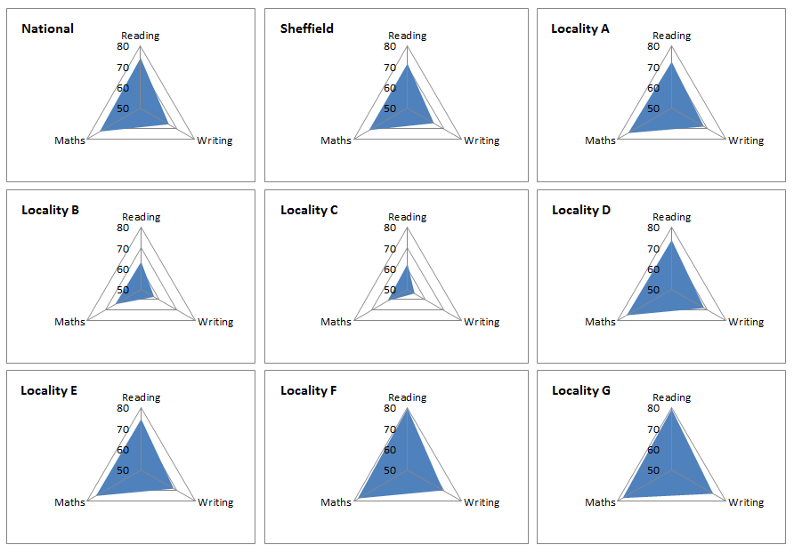
Key Stage 1 – subject comparison, % EXS in reading, writing and maths

Slide 6
2016 Headlines – Key Stage 2
New assessment framework – pupils working at the level of test in reading, maths and GPS have received a scaled score between 80 and 120.
Pupils working at a ‘higher standard’ are those achieving a scaled score of 110 or higher in reading and maths or working at ‘greater depth’ in writing.
The new expected standard is estimated to be roughly equivalent to a level 4a in reading and between a 4b and 4a in maths.
Progress will calculated using the difference between the KS2 scaled score and the KS1 average points score. BUT there is no individual level progress target for pupils.
Schools will be below floor if:
  û fewer than 65% of pupils reach the expected standard in ALL of reading, writing and maths
  AND
  û the school is below the floor standard for ANY of the individual progress measures in reading (-5), writing (-7) or maths (-5).
  NB confidence intervals will be applied to the progress measures similar to the method used to show significant ‘greens’ and ‘blues’ in RAISE.

Slide 7
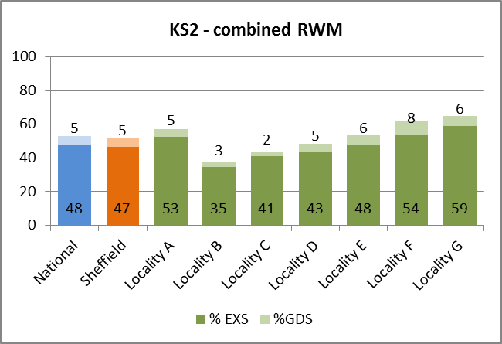
2016 Headlines – Key Stage 2
Significant difference in the % achieving the expected standard in reading, writing and maths – 52% compared to level 4+ (78% in 2015)
Sheffield has closed the gap and is only 1% point below national average (53%)
5% of pupils achieved the higher standard or greater depth in all three subjects, equivalent to the national average)
For individual subjects the largest gap is for reading – Sheffield 62% compared to a national average of 66%
EXS – working at the expected standard
GDS – working at the higher standard / greater depth

Slide 8
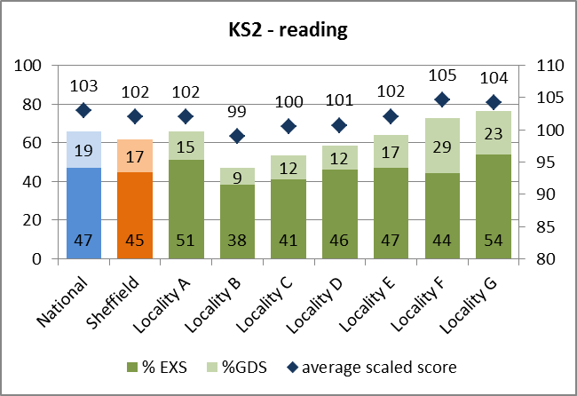
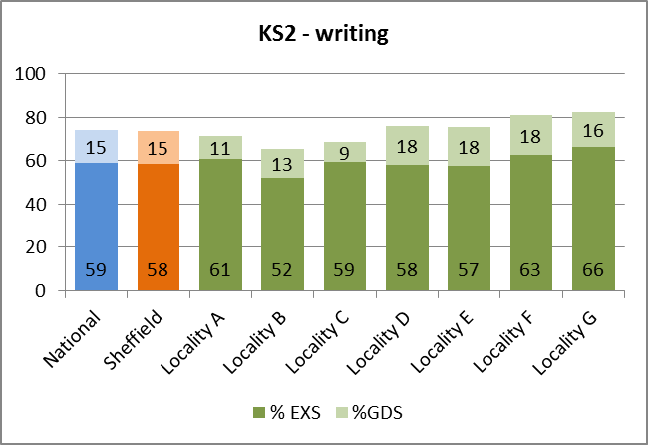
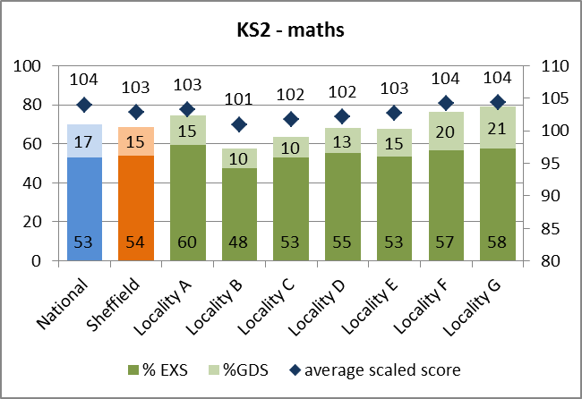
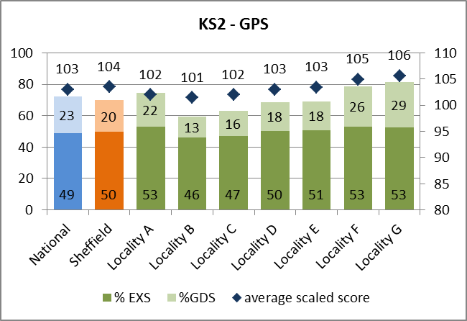
2016 Headlines – Key Stage 2
EXS – working at the expected standard, GDS – working at the higher standard / greater depth,
average scaled score is only available for pupils who sat the tests i.e. were not working below the standard of the tests

Slide 9
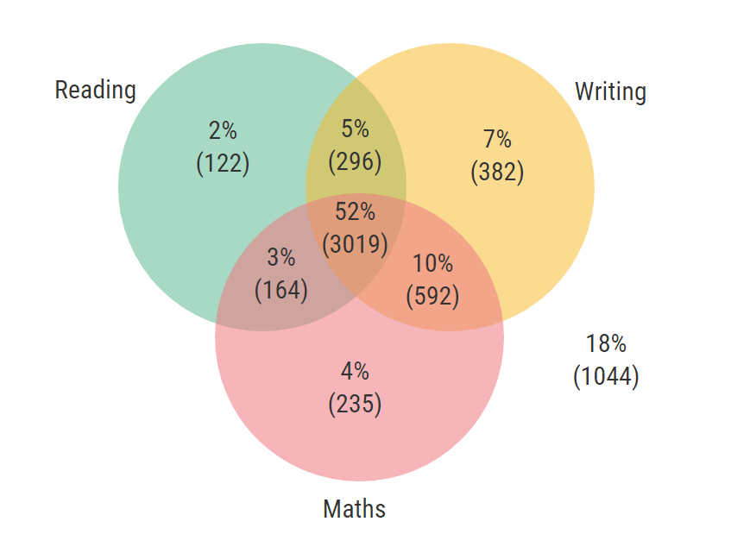
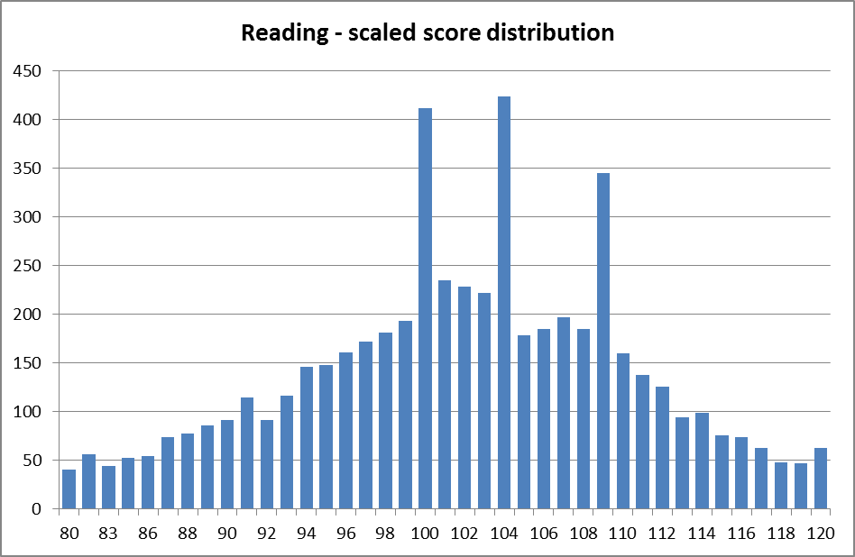
Key Stage 2 – subject breakdown
Reading tended to be the limiting factor that prevented pupils achieving the combined measure. Only 2% achieved the expected standard in reading only.
78% of pupils achieved the expected standard in at least one of 3 subjects.
17% achieved the expected standard in writing but not in reading.
6% of pupils scored 98 or 99 points in reading (i.e. just missed the threshold).

Slide 10
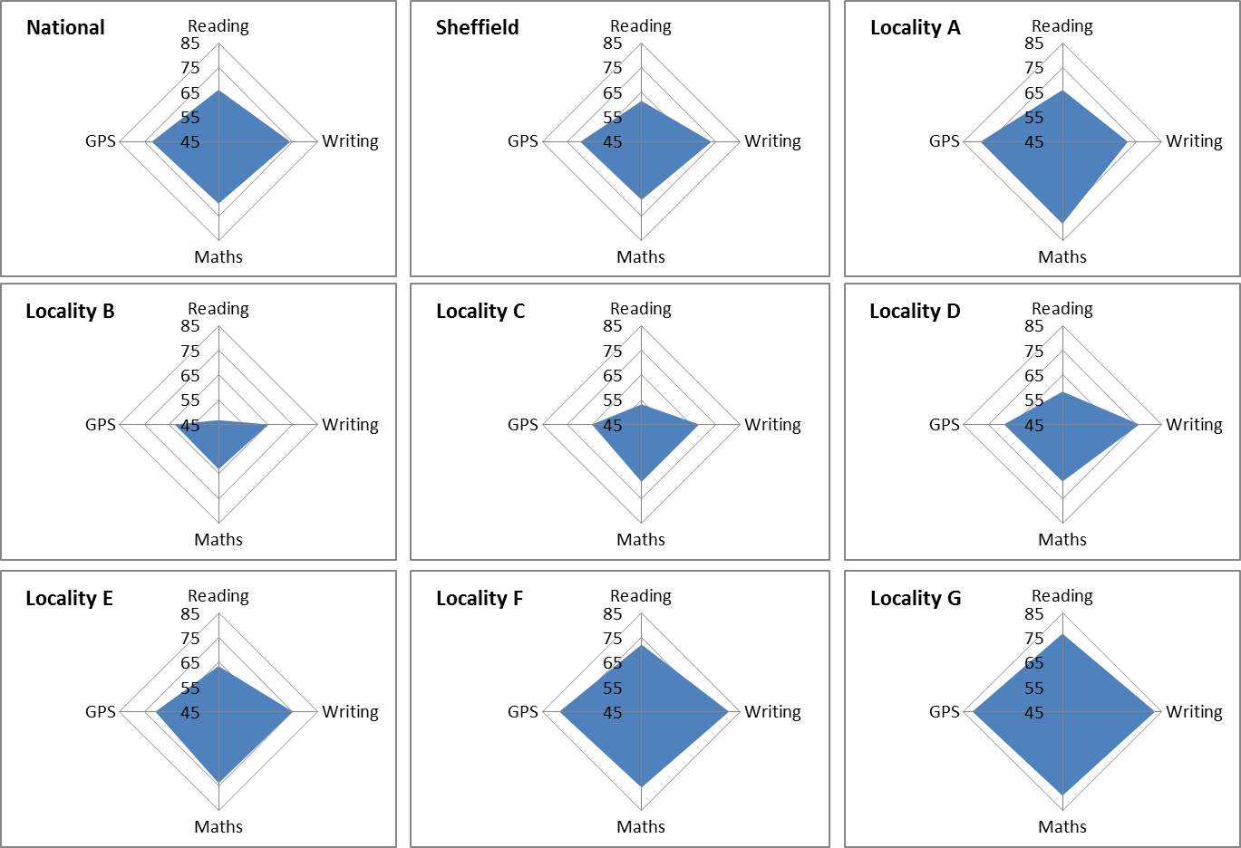
Key Stage 2 – subject comparison, % EXS in reading, writing, maths & GPS

Slide 11
How does Sheffield’s performance compare to other LAs?
National rankings give an indication of how Sheffield’s performance compares to other local authorities – provisional data shows Sheffield ranks 92 out of 150 LAs (1 is best performance) on the combined measure, this is an improvement compared to the 2015 rank of 116.
Sheffield deprivation ranking is 105.
Subject | National rank 2013 | National rank 2014 | National rank 2015 | National rank 2016 (provisional)
Combined RWM | 123 | 117 | 116 | 92
Reading | 139 | 143 | 142 | 119
Writing | 131 | 122 | 126 | 77
Maths | 129 | 115 | 103 | 99
GPS | 141 | 106 | 117 | 104
National ranks have improved across all measures but reading is still the weakest performing subject relative to other LAs

Slide 12
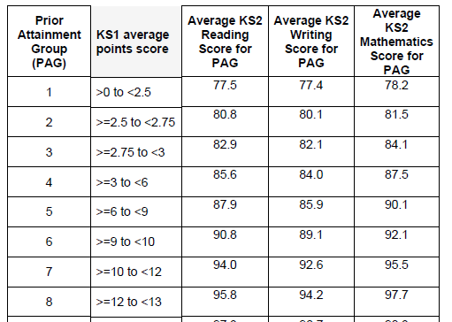
KS2 - Progress calculation
Provisional progress data was made available to schools on 1st September
New progress measures are value-added and measure the distance travelled between Key Stage 1 and Key Stage 2.
Steps in working out progress....
1. Calculate KS1 average points score – average of reading and writing combined with maths
2. Each pupil is assigned to a prior attainment group based on their KS1 average points
A progress score of 0...
means the pupil has achieved the level of KS2 attainment expected given their KS1 score
A progress score above 0...
means the pupil has achieved a higher level of KS2 attainment than predicted from their KS1 score
A progress score below 0...
means the pupil has achieved a lower level of KS2 attainment than predicted from their KS1 score
3. The DfE have calculated the average score for each subject for each prior attainment group. Where a pupil does not have a scaled score (e.g. in writing or if they are working below the test) they are assigned a score based on their teacher assessment.
4. Compare the pupils actual KS2 score with the expected score – the difference is the pupil’s progress score.
The school progress score is an average of the individual pupil scores

Slide 13
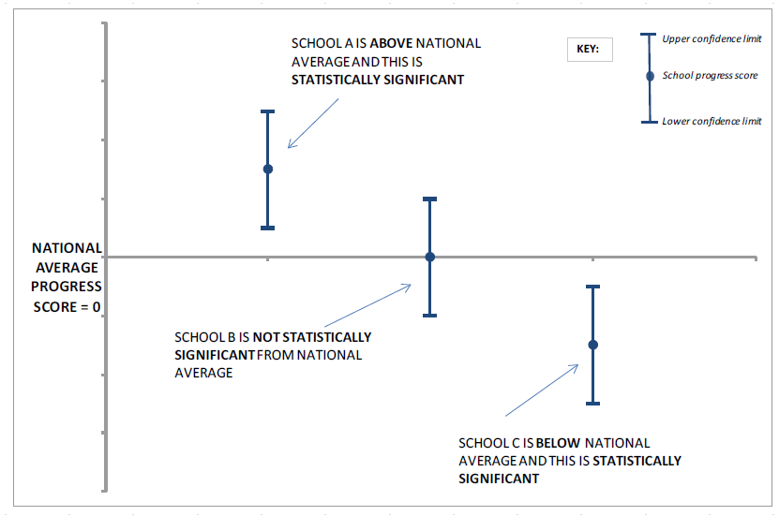
KS2 - Progress – statistical significance and floor standards
A school’s overall progress scores show on average whether pupils make more or less progress compared to pupils with similar prior attainment nationally.
A significance test will be applied to the progress scores to determine if they are significantly different from 0. 0 represents national average progress.
If the school’s progress score is below -5 in reading or maths or below -7 in writing AND the school has achieved less than 65% then the school is below the floor standard*
*providing a sufficient number of pupils have progress results

Slide 14
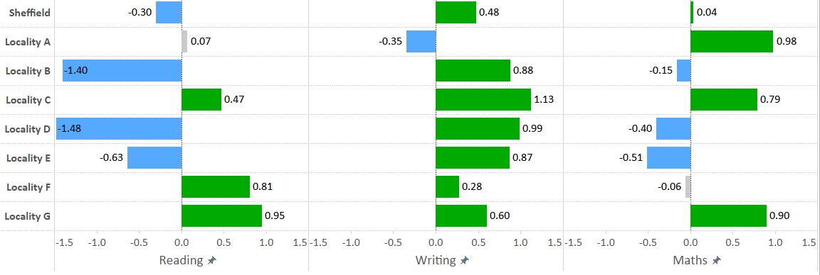
KS2 - Progress – results
Overall progress scores for Sheffield are above average for writing, close to 0 for maths and below 0 for reading.
blue = significantly below 0, green = significantly above 0, grey = not significant

Slide 15
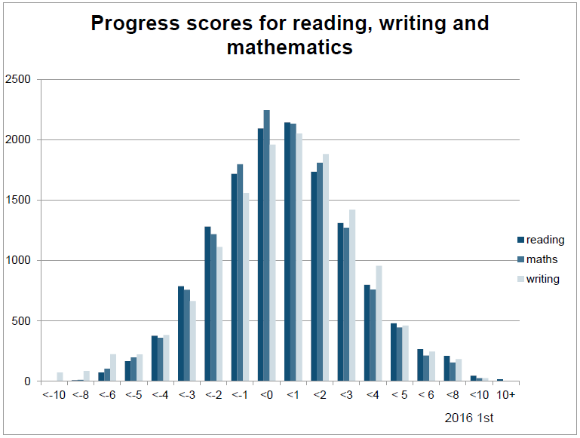
KS2 - Progress – distribution of scores
Sheffield
National
Sheffield
Sheffield

Slide 16
Pupil groups
Group discussion on progress analysis by pupil groups.....

Slide 17

Children’s Profile

Slide 18
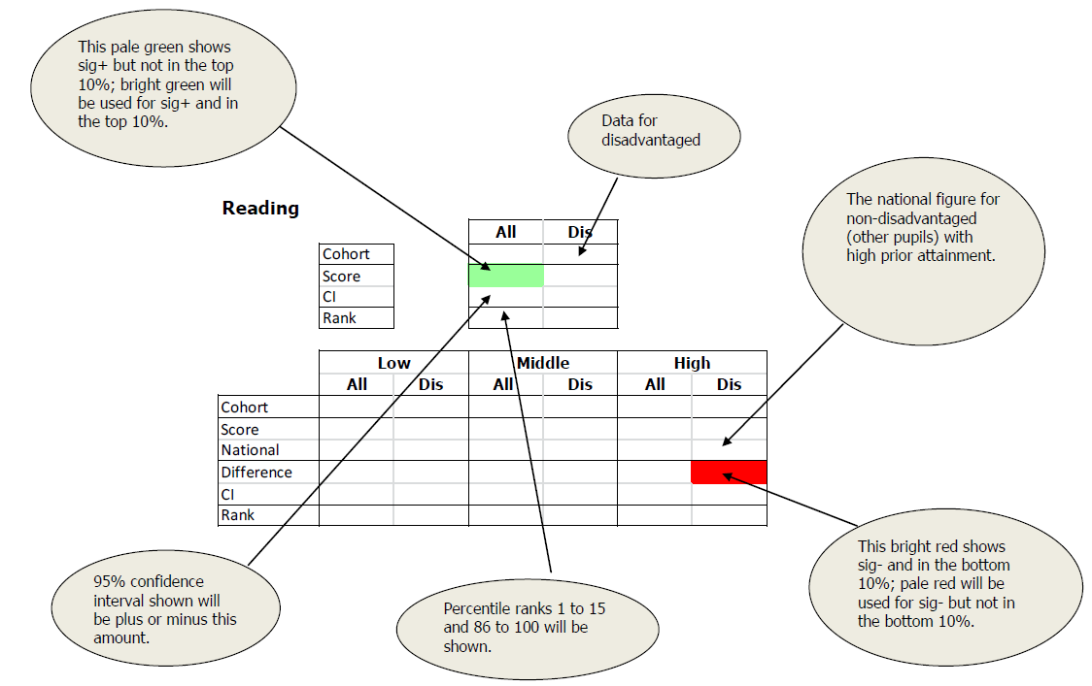
RAISEonline
Available late October – dates not yet released
New thresholds, expected standard and greater depth / higher standard
Average scaled scores
New progress measures
Summary shows breakdown for low, middle, high prior attainment for all pupils and disadvantaged pupils.
Disadvantaged pupils are compared against non-disadvantaged pupils nationally.
Statistical significance is applied as before AND there will be additional shading to indicate top / bottom 10%
Example progress report

Slide 19
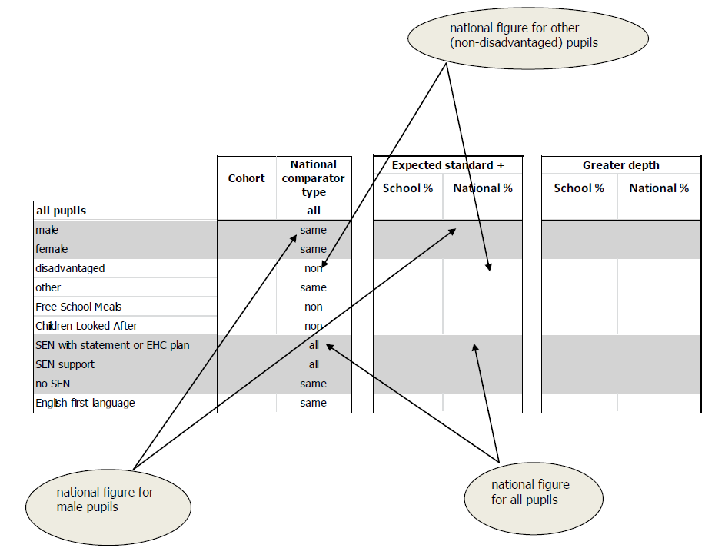
RAISEonline
Pupil group comparisons fall into 3 types:
  comparison against the same group (for example gender, EAL, non SEN)
  comparison against non-disadvantaged group (disadvantaged, CLA, FSM)
  comparison against all pupils (SEN)

Slide 20
Other key releases
Inspection dashboard – to be used for inspection preparation, likely to be released after RAISE, content not yet announced
Primary Performance Tables – 15th December
Floor standards – provisional data already includes progress and the thresholds have been announced but will not be confirmed until Performance Tables
Coasting schools.....

Slide 21
KS2 - Coasting Schools
The DfE plans to inform schools if they meet the coasting definition after the 2016 Performance Tables are published in December. These schools will need to demonstrate that they have sufficient capacity to improve or face further action.
Schools will be identified as coasting using data from 2014, 2015 and 2016.
  In 2014 and 2015 a school is coasting if fewer than 85 per cent of pupils achieve Level 4+ in reading, writing and mathematics and the percentage of pupils making expected progress in reading, writing and maths are all below the national medians.
  In 2016 a school is coasting if fewer than 85 per cent of pupils achieve the new expected standard across reading, writing and mathematics and pupil progress is below the threshold in any one of reading, writing or maths. The progress measure for coasting will be calculated in the same way as the progress floor standards but the coasting standard will be set at a higher level than the progress floor standard.
  A school is only classified as coasting if it meets these criteria in ALL 3 years
School identified as coasting after the 2016 accountability data is published will be notified and will become eligible for intervention. However, they will not “automatically be subject to intervention”.

Slide 22
Primary Categorisation
Each locality has a process for carrying out the categorisation:
  School Information Forms are completed.
  School & Locality data is available.
  Locality & Learn Sheffield categorise each school and feed back (where necessary) by Friday 14th October.
  Learn Sheffield writes to all schools on Monday 17th October.
  School Profiles will be shared once complete but this will not delay the process.
We have agreed that we will write to all schools at the same time, even if that leads to a delay for some localities.
The letters will be accompanied by a Guide to Categorisation and some accompanying documents – everything goes to the Headteacher (or equivalent) & Chair of Governors (or equivalent).
The process is about the effective targeting of resources and is based on the principle that each school has an entitlement.

Slide 23
Achievement Strategy
The strategy includes the activity that will support all schools in preparation for Statutory Tests in 2017:
  Moderation – city, locality & school level
  Tracking – using predictions to inform support for schools
  Briefings – school leaders & FS2/Y2/Y6 teachers
  Support & Guidance (including Access Arrangements)
The team working on this are LSIPs and Associate LSIPs – the discussion and decisions will be taken at the Primary Improvement Board in October.
The strategy also includes school improvement activity (school self evaluation, school improvement planning, support with data analysis, Ofsted preparation, etc.) which will be offered to schools as part of the support and challenge entitlement following categorisation.

Slide 24
Locality Action Plans
Each locality will develop a School Improvement Action Plan to capture the school improvement activity – there is flexibility about when, how, etc. The content will be based upon the agreement between Learn Sheffield and each locality.
The categorisation process may lead to some additional or different activity.
The development of the locality data picture may lead to some additional or different activity.
The achievement strategy may lead to some additional or different activity.
The plan needs to be a working document and, most importantly, needs to support the work of the locality. Each locality can decide how to approach this additional information.

