Slide 1
A new approach to inclusion
Tim Bowman
Head of Inclusion and Targeted Services

Slide 2
Background
Vision for every child, young person and family to be safe and achieve their potential
Significant minority have needs, disadvantages and vulnerabilities
Despite successes and good practice, statistics are not generally positive for this minority (PA, exclusions)
Pattern of need is changing (autism) and not matched by provision
Funding system under pressure and not incentivising right behaviours
Neither a centralised model nor a “one size fits all” approach can deliver for inclusion. City too big, challenges too varied and resources too much in demand

Slide 3
Meeting the challenge of inclusion requires us all to change how we work
Targeting our investments in favour of inclusion – no reduction in inclusion funding overall
Changing the way we work - more local control and influence over resources, more choice for parents and families
Establishing an integrated locality model comprising:
Current Early Help and Support Services (MAST)
A reorganised inclusion service with a reinvestment of resources into localities for early help / prevention
Current SEND spend
Targeted additional investment
Through this change localities will have greater incentive to develop inclusive practices and more freedom to determine how resources are allocated and services commissioned

Slide 4
Locality Working
Key aim to develop good inclusive practices through local sharing of expertise, resources and good practice
Provide a team around an area
Give localities freedom to determine how resources are allocated and services commissioned
Special schools are vital to this model. We will work with special schools as a locality in their own right focused on working with young people with the most complex needs

Slide 5
Delivering this model requires all partners to change
Inclusion support must be integrated and re-organised through localities
Sheffield Inclusion Centre offer must be re-commissioned
Processes around SEND funding must change and incentivise inclusion
Funding and resources must be released from intervention to prevention
MAST model must be integrated: ensuring consistent assessment, early help and whole family approaches are adopted

Slide 6
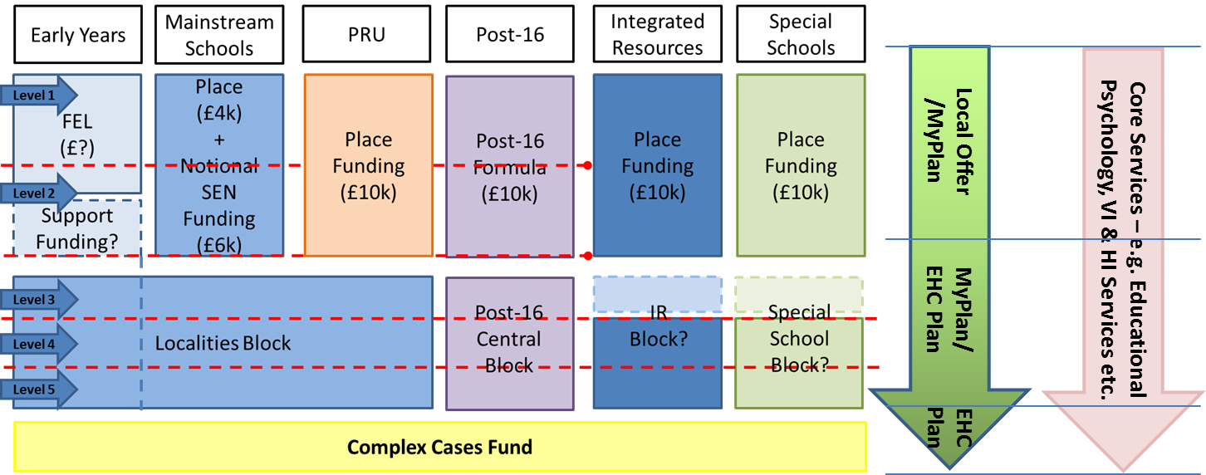
High Needs Funding: Draft Future Model: April 2016
Locality Based Model, supported by Special Schools
Descriptors of Need and Provision Matrix supported by use of “My Plan”
Parity across the system underpinned by strong accountability
Funding follows the pupil/student

Slide 7
Decisions taken by the School Forum
That we should move to a localities based funding and delivery model from April 2016.
That Banded Funding ceases to exist with immediate effect and that schools in localities should work together to manage existing and new support needs within their current resources.
The School Forum has also:
Commissioned the special school sector, IRs and Sheffield City Council to agree the package of outreach support to be provided to mainstream schools for the remainder of this year.
Asked the EP Service start working with schools to re-assess banded pupils against the Sheffield Support Grid.
Asked Sheffield City Council to:
identify an amount of funding for each locality to support the costs of administrating this approach for the remainder of this financial year.
Work with localities C and G to develop a SLA for use by all localities with their schools.
Reconstituted its Working Group to develop the detailed model for how funding will be allocated to localities from April 2016.

Slide 8
Next Steps (1)
School leaders have so far been supportive on these policy proposals
But have raised the following issues:
Capacity
Practical challenges of moving quickly
Moderation and Equity
Availability and quality of support
The alignment of key initiatives (early help, inclusion, school improvement)

Slide 9
Next Steps (2)
We (SCC) have already re-organised some of our workforce (SEN, EP) and are working with heads to overhaul “behaviour support”
We are working with Learn Sheffield to design an integrated model in localities
We need to learn from pilots that are underway
We know that localities need resources (£s and people) to deliver this work

