Slide 1
Preparation for Adulthood
Training for education providers and advisory services
Academic year 2021/22

Slide 2
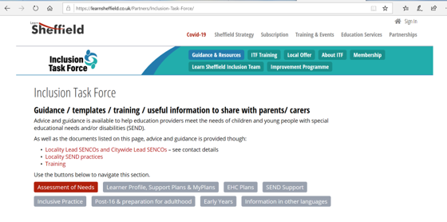
Introduction
Training builds on Annual Review training available on learnsheffield/Inclusion Taskforce website
Training delivered in 3 parts:
Training power point
Round table discussion
Further training and Q&A
Notes:
Meeting host to share slides / documents and spot light on presenters as needed in zoom throughout

Slide 3
Session aims
To explain why Preparation for Adulthood (PFA) is important
To consider best practice for supporting transition from age 14 into adult life
To explain what should be done each year from age 14 to the point a young person leaves formal full-time education
To consider the legal responsibilities and requirements on schools to support PFA for children with EHC Plans
To build on training on Annual Reviews of EHC plans
To consider how children at SEN Support and other vulnerabilities can be supported
To consider how health and care needs should be supported as part of PFA work
To answer questions that SENCOs and services have about PFA

Slide 4
Some questions to hold in your mind whilst completing this training
What is the focus and aspiration for each young person in adult life?
What do you need to do to help learners with SEND succeed in becoming adults?
What needs to be different to what is in place now?

Slide 5
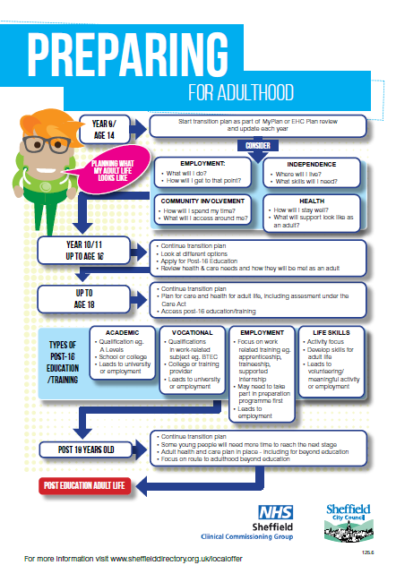
What is Preparation for Adulthood?
Must be a focus of all reviews from Year 9 onwards
Employment
Independence
Community participation
Managing health
Transition between children and adult services
When an EHC plan is likely to be ceased within the next 12 months ensure plan for the future
https://www.youtube.com/watch?v=99AwXrcQwgE&feature=youtu.be
https://www.learnsheffield.co.uk/Downloads/InclusionDocuments/20-21/Prep%20for%20adulthood%20updated%20Nov%202020.pdf
Notes:
Include link for training video for PfA

Slide 7
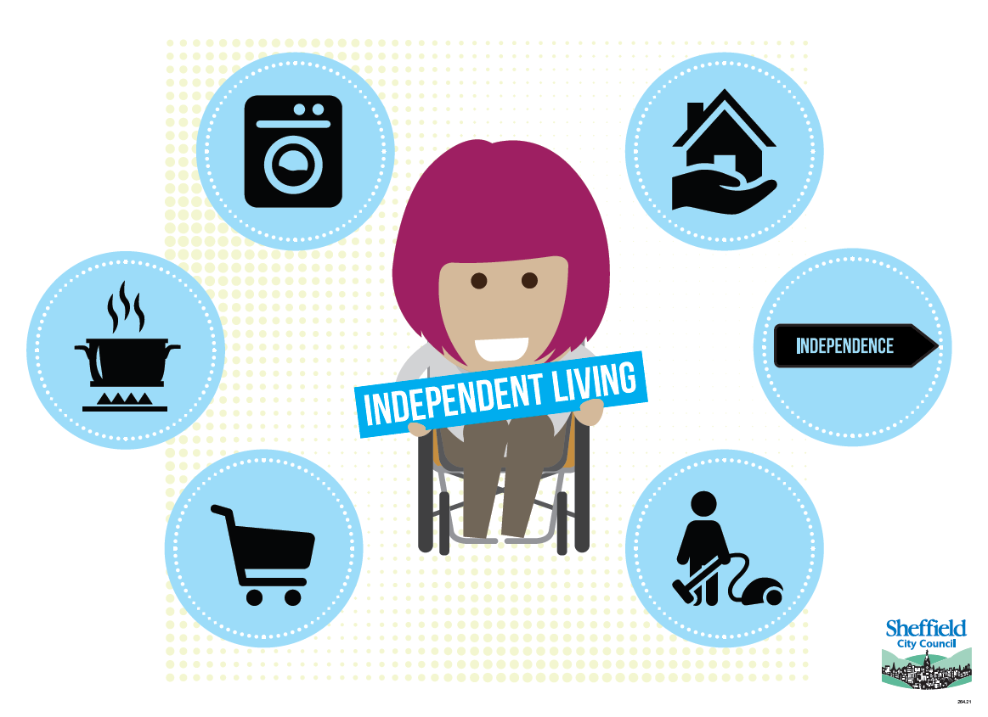

Slide 10
Why is this important?
Impact on individual
Impact on families
Creating opportunity and choice
Access to and focus on employment
Opportunities for independence
Cost to the state
More than academic study
Clear and effective planning
Notes:
Person centred – all about the young person and their specific needs
Working in partnership with the parents
Doing things at the right time
Preventing a cliff edge

Slide 11
Pause and think….
What are the barriers to us doing this?
Pause this video for a few minutes and reflect on these questions
Record any questions you have as we will look to answer these in the Q&A session

Slide 12
What the code of practice says
SEND Code of practice chapter 8
Being supported towards greater independence and employability can be life-transforming for children and young people with SEN. This support needs to start early, and should centre around the child or young person’s own aspirations, interests and needs. All professionals working with them should share high aspirations and have a good understanding of what support is effective in enabling children and young people to achieve their ambitions. (7.37)

Slide 13
What the code of practice says
Preparing for adulthood means preparing for:
higher education and/or employment – this includes exploring different employment options, such as support for becoming self-employed and help from supported employment agencies
independent living – this means young people having choice, control and freedom over their lives and the support they have, their accommodation and living arrangements, including supported living
participating in society, including having friends and supportive relationships, and participating in, and contributing to, the local community
being as healthy as possible in adult life (7.38)

Slide 14
Starting Early
When a child is very young, or SEN is first identified, families need to know that the great majority of children and young people with SEN or disabilities, with the right support, can find work, be supported to live independently, and participate in their community. Health workers, social workers, early years providers and schools should encourage these ambitions right from the start. (8.5)

Slide 15
Support from Year 9 onwards
High aspirations about employment, independent living and community participation should be developed through the curriculum and extra-curricular provision. Schools should seek partnerships with employment services, businesses, housing agencies, disability organisations and arts and sports groups, to help children understand what is available to them as they get older, and what it is possible for them to achieve. (8.7)
For teenagers, preparation for adult life needs to be a more explicit element of their planning and support. (8.8)

Slide 16
EHC Plans: Preparing for Adulthood Reviews
Local authorities must ensure that the EHC plan review at Year 9, and every review thereafter, includes a focus on preparing for adulthood. It can be helpful for EHC plan reviews before Year 9 to have this focus too. Planning must be centred around the individual and explore the child or young person’s aspirations and abilities, what they want to be able to do when they leave post-16 education or training and the support they need to achieve their ambition. Local authorities should ensure that children and young people have the support they need (for example, advocates) to participate fully in this planning and make decisions. Transition planning must be built into the revised EHC plan and should result in clear outcomes being agreed that are ambitious and stretching and which will prepare young people for adulthood. (8.9)

Slide 17
Support to prepare for higher education and/or employment
This should include identifying appropriate post-16 pathways that will lead to these outcomes. Training options such as supported internships, apprenticeships and traineeships should be discussed, or support for setting up your own business. The review should also cover support in finding a job, and learning how to do a job (for example, through work experience opportunities or the use of job coaches) and help in understanding any welfare benefits that might be available when in work (8.10)

Slide 18
Support to prepare for independent living
including exploring what decisions young people want to take for themselves and planning their role in decision making as they become older. This should also include discussing where the child or young person wants to live in the future, who they want to live with and what support they will need. Local housing options, support in finding accommodation, housing benefits and social care support should be explained (8.10)

Slide 19
Support in maintaining good health in adult life
including effective planning with health services of the transition from specialist paediatric services to adult health care. Helping children and young people understand which health professionals will work with them as adults, ensuring those professionals understand the young person’s learning difficulties or disabilities and planning well-supported transitions is vital to ensure young people are as healthy as possible in adult life (8.10)

Slide 20
Support in participating in society
including understanding mobility and transport support, and how to find out about social and community activities, and opportunities for engagement in local decision-making. This also includes support in developing and maintaining friendships and relationships (8.10)

Slide 21
EHC review
The review should identify the support the child or young person needs to achieve these aspirations and should also identify the components that should be included in their study programme to best prepare them for adult life. It should identify how the child or young person wants that support to be available and what action should be taken by whom to provide it. It should also identify the support a child or young person may need as they prepare to make more decisions for themselves. (8.11)

Slide 22
What does this all mean for us?

Slide 23
Transition planning for young people
Must be young person centred, in partnership with the family Introduction to Person-centred Planning Tools (preparingforadulthood.org.uk)
Needs to be a focus throughout secondary
Incorporate with whole school approach – what is available to all?
Statutory responsibilities for schools eg IIAG
More than academic and employment – focus on all 4 areas of preparation for adulthood (employment, independence, community participation, good health)
Good exit planning – stepping into post-education life and everything needed to do this

Slide 24
Transition planning for young people
Person centred
Golden thread – Aspiration, Outcome, Needs, Provision
What matters and what’s important
Meetings are 1 part of the process
Session 3 will focus more on these areas (aspirations, outcomes, meetings)

Slide 25
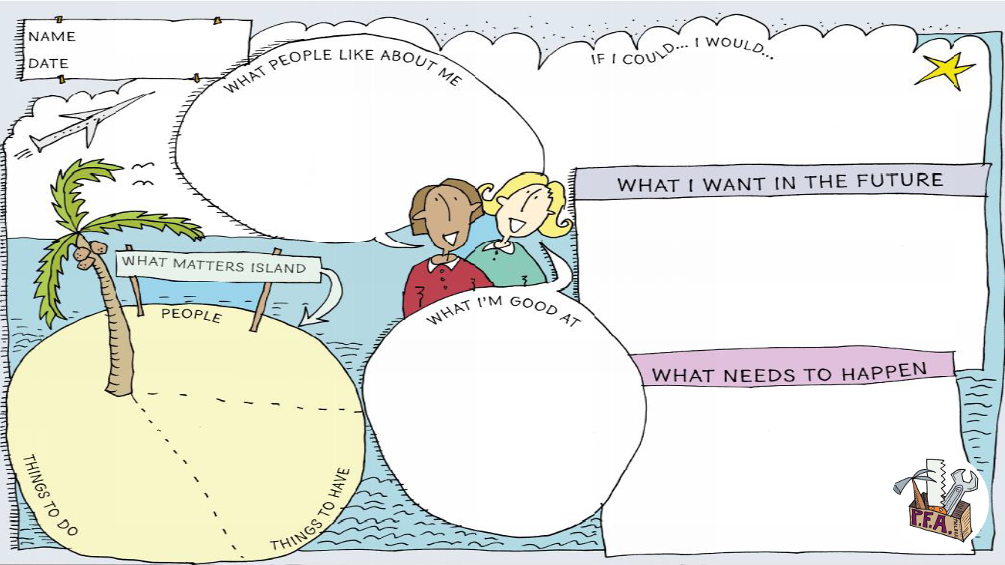

Slide 26
Parent or Young Person decision?
Everything changes at end of statutory school age – decisions become the young persons
Parent engagement is vital – as is helping the young person to understand their responsibilities and rights
Mental Capacity Act – Capacity is assumed unless assessed otherwise
Young People may need to be supported by parents or advocates to make decisions – they have the right to make a bad decision
Parents may need to be supported to accept changes for adult life – though all want good progress!

Slide 27
Timeline for Preparation for Adulthood
Before Year 9 – Developing independence
Year 9 – Transition plan must be put in place
Year 10 / 11 – Decision making for the future - clear plan for adult life, defined outcomes, plan reviewed to be fit for post-16 education, placement decided
Up to age 18 – Continue to implement plan, establish what, if any, further education or training may be required to meet outcomes
Post 18 – Continued learning if required. Most expected to complete learning at same age as peers
Up to age 25 – EHC plan ceases when educational outcomes to support into adult life and academic progress are complete, not at age 25. EHC Plan does not continue in Higher Education
https://www.learnsheffield.co.uk/Downloads/InclusionDocuments/20-21/Prep%20for%20adulthood%20updated%20Nov%202020.pdf
Notes:
Include link for training video for PfA

Slide 28
Pause and think….
What has worked well in your experience to support transition planning?
What are the barriers to effective transition planning?
Pause this video for a few minutes and reflect on these questions
Record any questions you have as we will look to answer these in the Q&A session

Slide 29
Types of post-16 education / training
Academic – Qualification led e.g. A-levels – school or college, leads to employment or university
Vocational – Work related qualifications – college or training provider, leads to employment or university
Employment based – Focus on work through apprenticeship, traineeship, internship – leads to employment
Lifeskills – Activity focused – develops skills for adult life – leads to volunteering, meaningful activity or employment
Young people may move between these pathways, but good planning should ensure that this is identified early

Slide 30
Careers guidance
Maintained schools and pupil referral units (PRUs) have a statutory duty under section 42A of the Education Act 1997 to ensure pupils from Year 8 until Year 13 are provided with independent careers guidance. Academies, including 16-19 academies, and free schools are subject to this duty through their Funding Agreements. FE colleges also have equivalent requirements in their Funding Agreements – their duty applies for all students up to and including age 18 and will apply to 19- to 25-year-olds with EHC plans. (8.27)
How is this threaded throughout work?
Who is responsible in your school/setting and how is this offered?
What is needed above and beyond the usual offer?

Slide 31
What is a Study Programme?
All students aged 16 to 19 (and, where they will have an EHC plan, up to the age of 25) should follow a coherent study programme which provides stretch and progression and enables them to achieve the best possible outcomes in adult life. Schools and colleges are expected to design study programmes which enable students to progress to a higher level of study than their prior attainment, take rigorous, substantial qualifications, study English and maths, participate in meaningful work experience and non-qualification activity. They should not be repeating learning they have already completed successfully. For students who are not taking qualifications, their study programme should focus on high quality work experience, and on non-qualification activity which prepares them well for employment, independent living, being healthy adults and participating in society. (8.30)

Slide 32
Preparing for a study programme
Transition plan needs to identify what will need to be included in the study programme to meet a learners needs and Preparing for Adulthood Outcomes including: * Universal * Targeted * Specific provision
It’s not about fitting the learner into a programme, but about creating a provision that holistically meets their needs
Focus on aspirations and outcomes in session 3 of this training

Slide 33
Work Experience and Partnerships – questions and challenges
How can we arrange work experience for those with SEND?
What partnerships can schools utilise? eg. housing agencies, arts groups, older learners, entrepreneurs, other adults with SEND in employment, higher education
Partnership working with post-16 providers to access taster activities in college that are meaningful to aspirations and address needs
Just as much entitlement as any other young person
What is already happening in school?
How are you communicating with families?

Slide 34
Pause and think….
What changes might you need to put in place to better support education and training?
Pause this video for a few minutes and reflect on these questions
Record any questions you have as we will look to answer these in the Q&A session

Slide 35
Health needs in adult life
Early planning is essential for a successful transition in health.
Transitions planning usually starts at 14 years, however some patients with long term conditions may start transition planning at 11 or 12.
The actual move to adult care can take place anywhere between 16 and 19 depending on the patient’s condition and their individual needs.
A transition plan is used to gradually plan and prepare a young person for adult services. Sheffield Children’s NHS Trust use the Ready Steady Go traffic light programme.
Part of the transition process is to look at where a young person’s ongoing healthcare needs can be best met. This may include at hospital, in the community, or through general practice (GP).

Slide 36
Health needs in adult life
The transitions process is led/coordinated by the doctors and nurses in the child’s health service. These professionals are there to:
Provide advice and guidance on managing health needs, and the changes to decision making responsibilities.
Support the young person and their parent / carers to plan for the future, particularly in cases of degenerative disease or life limiting conditions.
Ensure the young person (and their parent/carer) knows who to contact if there are any concerns, or to make or change appointments.
Make links to the adult services who will be responsible for ongoing care, and familiarise the young person with the new service.

Slide 37
Health needs in adult life
Transition from children to adult therapy services should be planned.
Therapy services may want to work with colleges to make sure that the young person has access to the correct equipment or make suggestions about reasonable adjustments that could be made to better support them.
Therapy services should be made aware early that a placement has been agreed. This is because sometimes they will need to ensure access to specific pieces of equipment that take time to plan for, order and check upon receipt to make sure it is as safe as possible.

Slide 38
Health services
Move to adult services becomes GP led where there is not complexity (3 comorbidities)
Families should discuss with involved health services – not assume provision continues in same way
Input is around specific tasks – e.g. you might have a Speech Therapist allocated to complete a communication assessment, or you might work with an OT around using the kitchen – i.e. intervention is not on-going / forever, but focused on an individual task.
Ensure that the young person accesses their right for an LD health check at 14 where they have a learning disability
Referrals to the Learning Disability team can take place from 16 onwards. For young people without a learning disability, the GP can make referrals to community OT/Physio, and you can self-refer to a lot of services.
Request to be put on the LD register via their GP if not already done so in childhood

Slide 39
Health needs in adult life
The key to successful transition in health is preparing the young person and their parents / carers early on.
By starting conversations ahead of time, young people and their families can feel more prepared to plan for the significant changes in adult services before transition begins.
Pause and think – how can you support the health transitions process?

Slide 40
Care planning
Key to preparation for adulthood – all parts of the plan and needs should be addressed
Need to consider areas that may prevent a young person moving through further education and on to independence
Particularly important for those who are on a life skills pathway
Statutory care provision / non-statutory support
Care routes being developed – 24/7 grid
The Local Authority have a duty to assess someone’s needs, but they do not have a duty to provide services. Universal Services available to everyone can help meet any needs.

Slide 41
What is the care Act?
The Care Act 2014 introduces a national eligibility threshold, which consists of three criteria, all of which must be met for a person’s needs to be eligible:
Whether a person’s needs are due to a physical or mental impairment or illness
To what extent a person’s needs affect their ability to achieve at least two or more specified outcomes.
And whether and to what extent this impacts on their wellbeing
Assessments should be conducted at an appropriate time for the young person as they move towards being 18 to ensure clear planning is in place.

Slide 42
Mental Capacity Act
The Mental Capacity Act applies to young people aged 16+ and this looks at an individuals’ ability to make their own decisions about key aspects of their life (for example, where to live, how to spend their money or how to be supported). If a young person cannot make such decisions, then a decision will be made in their best interest, involving people who know them well.

Slide 43
Areas to consider
Care Act – the right to access an assessment
Family responsibility and support
Travel
Plan for independent living
Community participation – not everything is via statutory services
Accessing activities outside of school and with growing levels of independence
Benefits entitlement
Notes:
Need to include benefits info

Slide 44
Developing independence
What is important for the young person to be as independent in adult life as they can be?
What are the barriers to this?
What teaching and training is needed to address this? How might the curriculum and provision in section F be developed to deliver it?
Areas such as:
Where to live
Managing money and appointments
Personal care and travel

Slide 45
Community participation
What is in the young person’s local area / community and how might they get involved and access this? (not just physical space)
What relationships does the young person have and need?
What is the young person worried about?
How do you work with families to consider what is in their community?
What is available that will help that is not social care provision?
Enables commissioning of provision for the future

Slide 46
Pause and think….
What changes might you need to put in place to better support health and care needs to support young people to move to adult life?
Pause this video for a few minutes and reflect on these questions
Record any questions you have as we will look to answer these in the Q&A session

Slide 47
Working together to make it work

Slide 48
Training part 2 & 3
Part 2 round table discussion
Part 3:
Aspirations and outcomes for PFA
Transition meetings / Annual reviews from year 9
Q & A

