Slide 1
SEND locality processes March 2020

Slide 2
Locality SEND processes
Locality SEND processes support schools in their duty to take “relevant and purposeful action to identify, assess and meet the SEN of the child or young person.” (Code of Practice, 6.63)
Support SENCOs in developing high quality provision matched to individual needs
Involve educational psychologists to add expertise and capacity, and enable a deeper local knowledge of our children
Are the mechanism to allocate top-up funding to schools and individuals
Allow localities to plan and deliver CPD aligned to their locality’s needs
Support the graduated approach and contribute to consistent practice across the city

Slide 3
How Locality SEND processes have developed
2015: Element 3, top up funding, was delegated to localities to distribute.
2015 to 2016: Localities asked to innovate and use funding to best meet the needs of the children in their locality. Each locality took a different approach
2016: Inclusion Taskforce (ITF) formed in response to concerns about our ability as a city to consistently and effectively meet the need of SEND pupils in mainstream
2016 to 2019: ITF reviewed and evaluated work in localities and the city’s advice services. SSG/SSGe developed as a consistent tool
2019: Locality SEND processes developed and agreed at Inclusion Taskforce to establish consistent systems to support schools and SENCOs in taking “relevant and purposeful action to identify, assess and meet the SEN of the child or young person.”(Code of Practice, 6.63)

Slide 4
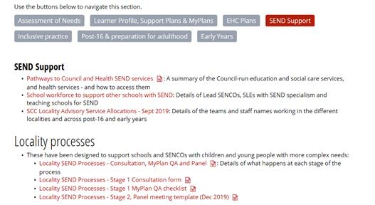
Where are locality processes and paperwork saved?
All information is on the Learn Sheffield website under Inclusion Taskforce: ww.learnsheffield.co.uk/inclusiontaskforce
Click on the SEND support red tab

Slide 5
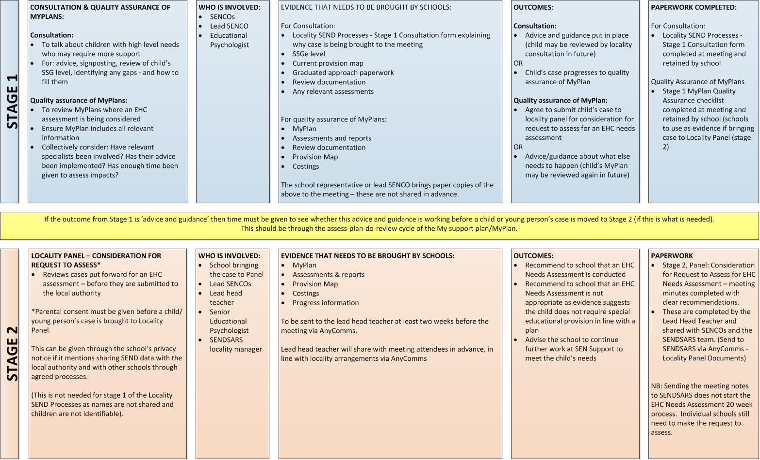
Locality SEND processes – Stage 1: Consultation and Quality Assurance
.
Stage 1 helps SENCOs with next steps for complex children. It provides:
Guidance to ensure accurate identification of needs
Advice and support about appropriate provision
Supports SENCOs in reviewing children’s MyPlans
Supports appropriate review cycles
Stage 1 is not about automatically moving onto stage 2. Instead it’s about good quality support at SEN support level.
Outcomes will either be continue with advice given and assess-plan-do-review or progress to stage 2
Localities may allocate funding at 1
Notes:
If useful:
The processes are not about judging the quality of the SENCO’s work. Their purpose is to provide additional support and advice from a range of professionals.
People at panel won’t always have the same opinion – as happens for all panels – but professional challenge and dialogue is important

Slide 6
Locality SEND processes – Stage 2: Considering progression to EHC Needs Assessment
.
Stage 2:
Provides advice and support about appropriate provision
Supports SENCOs and schools to demonstrate they have taken “relevant and purposeful action to identify, assess and meet the SEN of the child or young person.”
Makes recommendations from the locality to the EHC Panel regarding the need for statutory assessment
Outcomes at Stage 2 will either be a recommendation for the school to request a statutory assessment from the EHC Panel or to continue with assess-plan-do-review
Localities may allocate funding at Stage 2

Slide 7
Locality SEND Processes
Locality SEND processes are not part of the 20 week EHC Plan statutory process
But they help make the citywide statutory 20 week process more effective
If a Stage 2 Panel recommends a statutory assessment should be considered, it is the school’s responsibility to make the request to SENDSARS.
The school’s request to assess starts the 20 week process.

Slide 8
Feedback
Feedback to date has come from the Inclusion Taskforce and SENCO survey.
Strengths
Greater collaboration and school-to-school support
Access to advice
Good quality advice for parents
Increased confidence in understanding processes and graduated approach paperwork
Increased confidence (that a request is EHC Panel ready)
Much greater consistency across the city
Improved quality of information submitted to EHC Panel
Weaknesses
Experienced SENCOs may feel they can progress cases faster on their own
Huge amounts of paperwork are being uploading via AnyComms
Legacy issues, the level of need in some localities linked with limited advice services has left a significant back log

Slide 9
Next steps
Use information gathered from the Stage 1 and 2 processes to inform training, within FOS, Localities and Citywide.
Review the Locality SENCO job role to better understand and provide support in delivering high quality processes and guidance to school SENCOs.
Ongoing discussions/QA with outside professionals to develop their role in providing quality advice, ensuring we are moving towards having access to the right people at the right time.

Slide 10
Agreeing and allocating funding
Element 3 / top up funding continues to be delegated to localities to distribute in line with need
Funding increase to £3.4 million for financial year 2020/21
Funding put in place in line with the SSGe. Per pupil funding levels:
Pupils at Level 4: Average of £1,500 per pupil, with a range of £0-3,000.
Pupils at Level 5: Average of £4,500 per pupil, with a range of £3,000-6,000.
Each locality to determine how allocated
Funding decisions can be made at stage one, stage two or via a locality funding panel, depending on the arrangements already in place in each locality.

